Slide 1
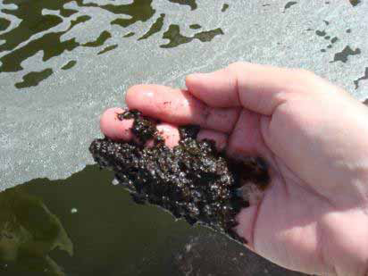
Algae- Hope or Hype?
Photo Courtesy Ami Ben-Amotz
John J Milledge

Slide 2
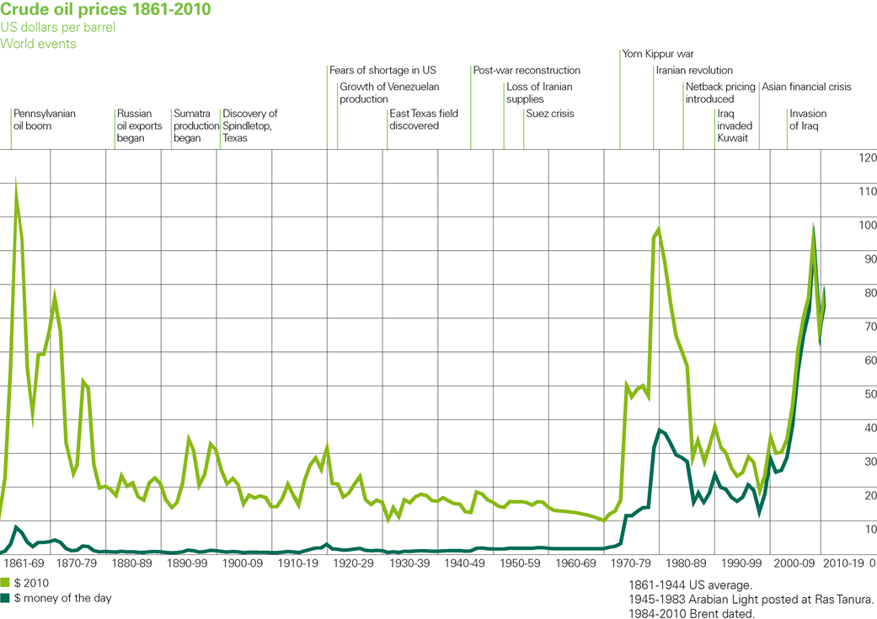
Fossil Fuel Costs are Increasing
BP statistical review of world energy June 2012

Slide 3
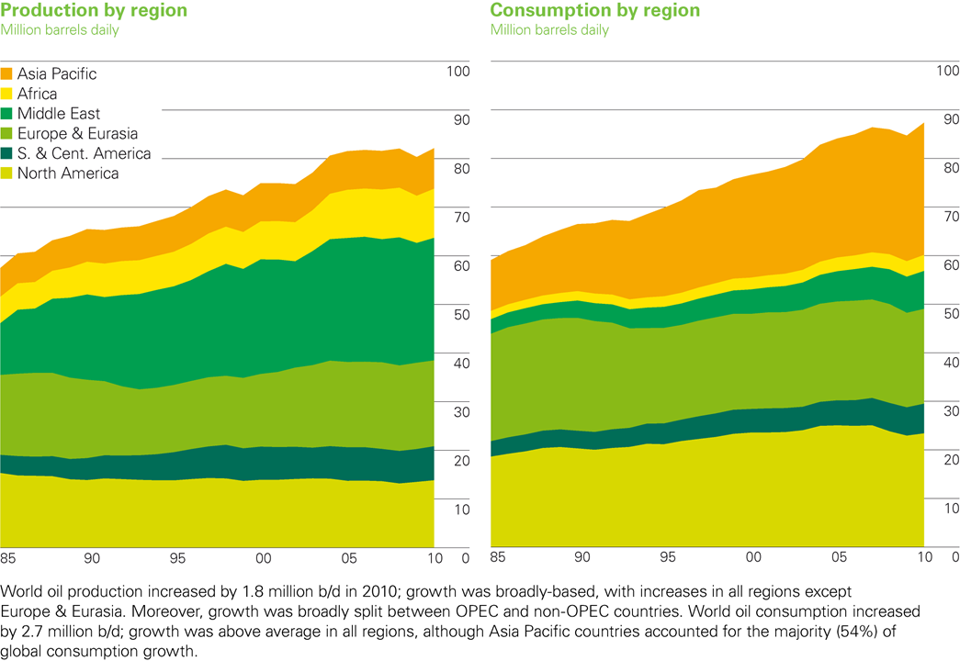
Demand for Fossil Fuel is Increasing
BP statistical review of world energy June 2012

Slide 4
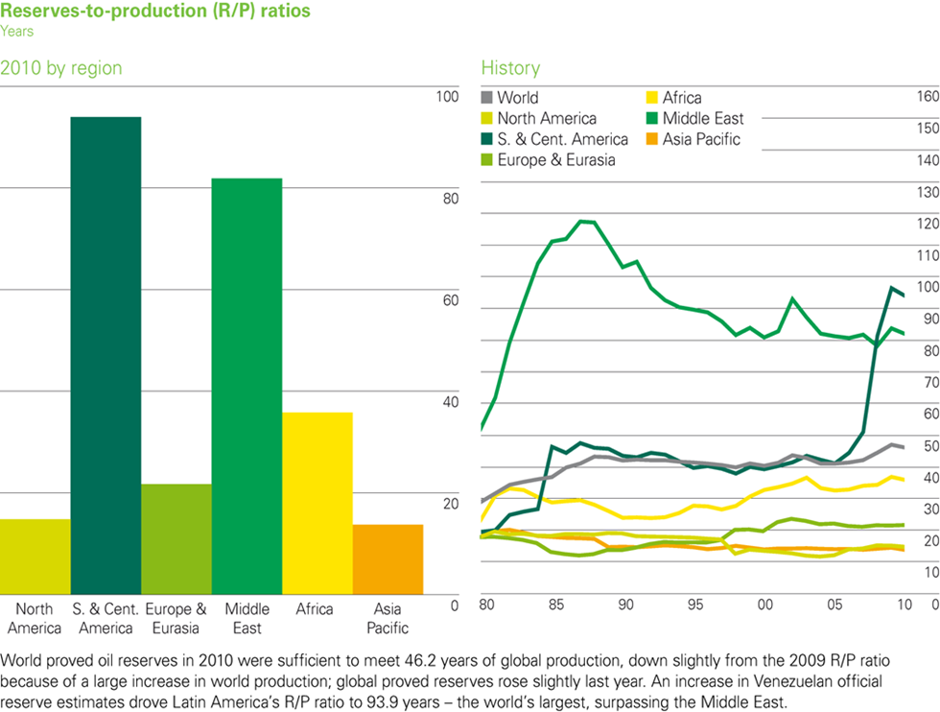
Reserves are Dwindling:
~50 years of Crude oil
BP statistical review of world energy June 2012

Slide 5

There will be a continuing demand for fluid fuels
No Electric Planes

Slide 6
Climate Change
“The overwhelming majority of scientists agree that this is due to rising concentrations of heat-trapping greenhouse gases in the atmosphere caused by human activities”
The Met Office
http://www.metoffice.gov.uk/climate-change

Slide 7
Help!

Slide 8
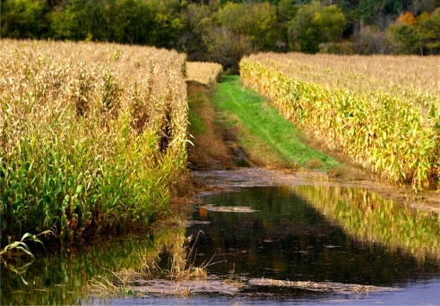
Biofuels to the Rescue?
First generation biofuels, derived from food crops such as soya and sugarcane, are controversial due to their influence on world food markets.
As world food prices reach new highs, a handful of U.S. politicians and hard-hit corporations are readying a fresh effort to forestall the use of more U.S. corn and soybeans as motor fuel.
Reuters Mon Feb 14, 2011 1:47pm GMT
http://uk.reuters.com/article/2011/02/14/us-usa-ethanol-support-idUKTRE71D0UR20110214

Slide 9
Third Generation Biofuels
Do not depend on agricultural or forestry ecosystems

Slide 10
NREL
National Renewable Energy Laboratory
From 1978 to 1996, the U.S. Department of Energy’s Office of Fuels Development funded a program to develop renewable transportation fuels from algae.
The total cost of the Program was $25.05 million
The overall conclusion of these studies was that in principle and practice large-scale microalgae production is not limited by design, engineering, or net energy considerations and could be economically competitive with other renewable energy sources
NREL, 1998. A Look Back at the U.S. Department of Energy’s Aquatic Species Program—Biodiesel from Algae. http://www.nrel.gov/docs/legosti/fy98/24190.pdf

Slide 11
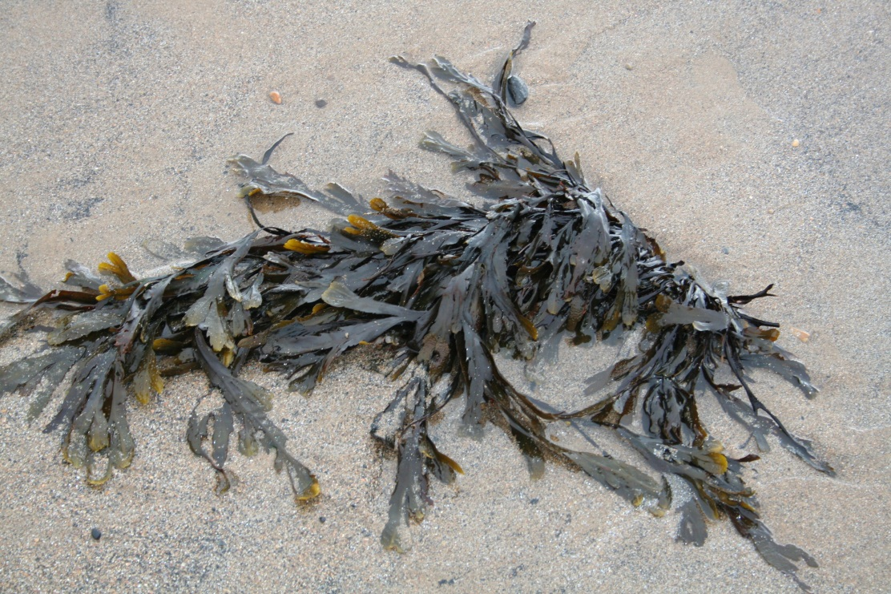
What are Algae?
Algae are a diverse range of aquatic ‘plants’ ranging from unicellular to multi-cellular forms and generally possess chlorophyll, but without true stems, roots and leaves
Seaweed – Pond Scum

Slide 12
Algae can be divided by size into two groups
Macroalgae most commonly known as “seaweed” which can grow to considerable size.
Microalgae as the name suggests are microscopic single cell organisms that exist individually, or in chains or groups. Their sizes range from a few micrometres (µm) to a few hundreds of micrometres.

Slide 13
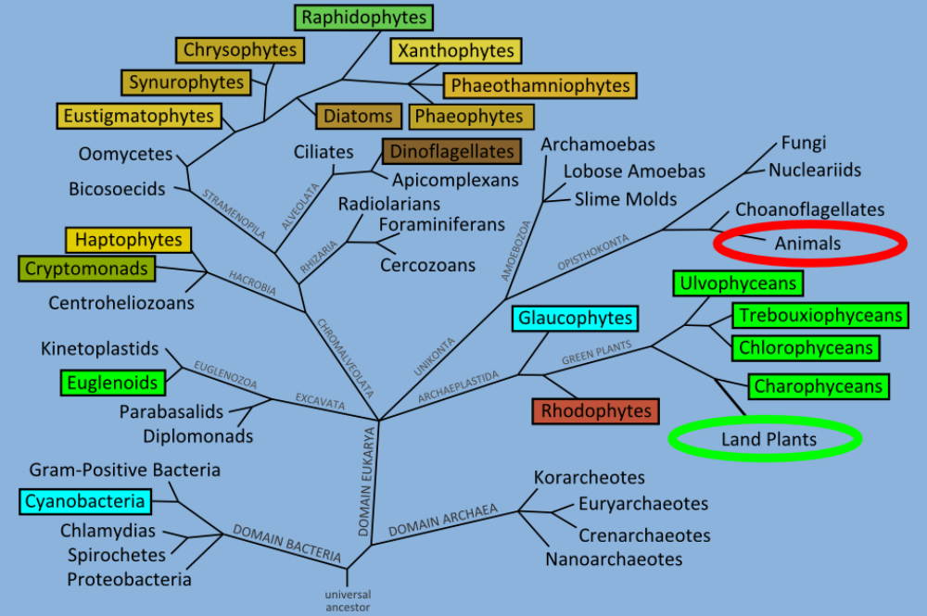
Algae on the Tree of Life
SCHLARB-RIDLEY, B. 2011. Algal Research in the UK. A Report for BBSRC.

Slide 14
What are microalgae?
Microalgae are a large and successful group of organisms, which flourish in the sea and fresh-water and naturally occurrence in virtually all water bodies.
Microalgae are the most primitive form of “plants” with most contain green chlorophyll, and use photosynthesis to convert energy from the sun.
Single cell organisms that exist individually, or in chains or groups. Their sizes range from a few micrometers (µm) to a few hundreds of micrometers.
They are the base of the aquatic food chain.

Slide 15
Microalgae are efficient plants
Microalgae are the most primitive form of plants. While the mechanism of photosynthesis in microalgae is similar to that of higher plants, they are generally more efficient converters of solar energy because of their simple cellular structure.
The cells grow in aqueous suspension and therefore have more efficient access to water, CO2, and other nutrients

Slide 16
Are Microalgae Important ?
Microalgae are responsible for over 50% of primary photosynthetic productivity on earth
Producing 50% of the oxygen. Try breathing alternate hours!
They budding sunlight factories for a wide range of potentially useful products, but as yet are barely used commercially
They produced the oil that we are using today.

Slide 17
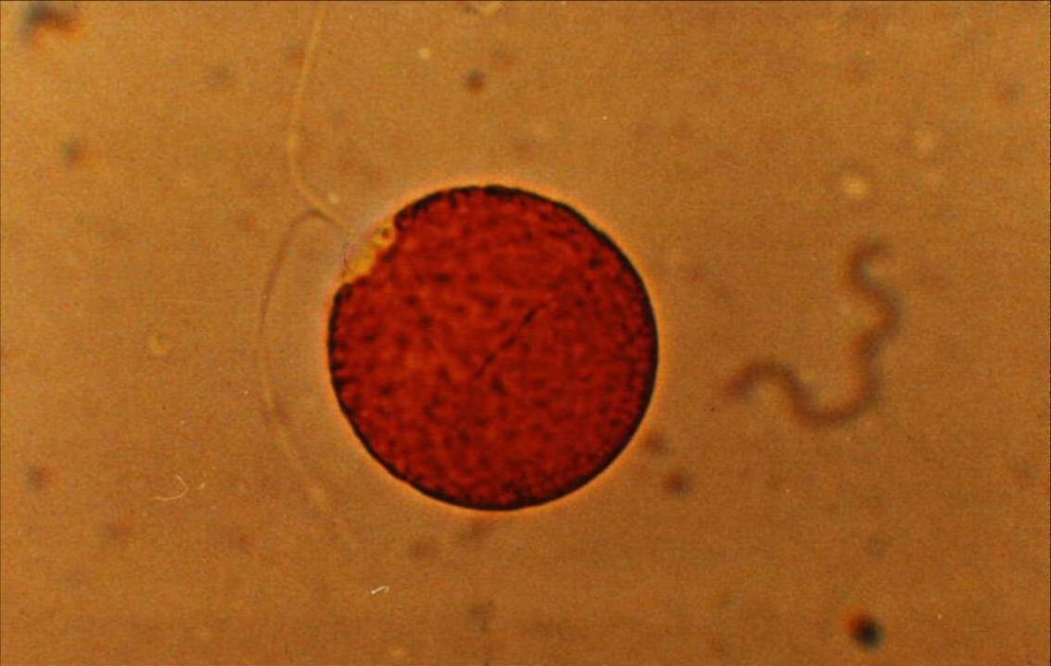
Oil doesn't come from dead dinosaurs
In spite of some popular misconceptions, oil doesn't come from dead dinosaurs.
Most scientists agree that oil was
derived from dead bodies microalgae over the millennia
Dunaliella Salina
Courtesy of Cognis Australia Pty Ltd

Slide 18
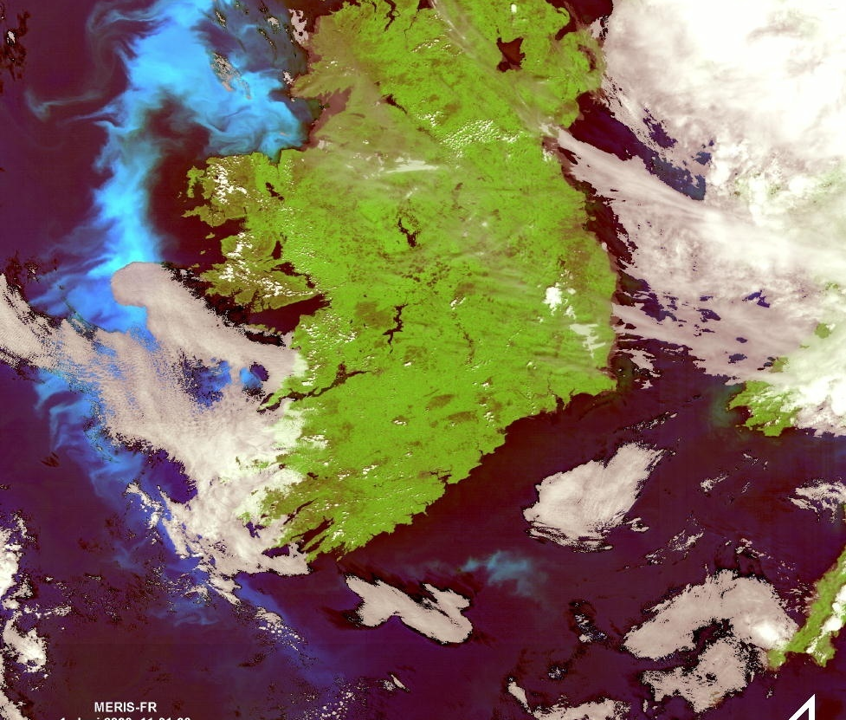
The typical algae bloom along the western coast of Ireland
Observed on June 01 , 2008, by MERIS (Medium Resolution Imaging Spectrometer) on board of the European satellite ENVISAT.
When phytoplankton population increases under favourite conditions the surface water gets coloured from brown to green and light-blue.
Source the World Data Centre for Remote Sensing of the Atmosphere (WDC-RSAT)

Slide 19
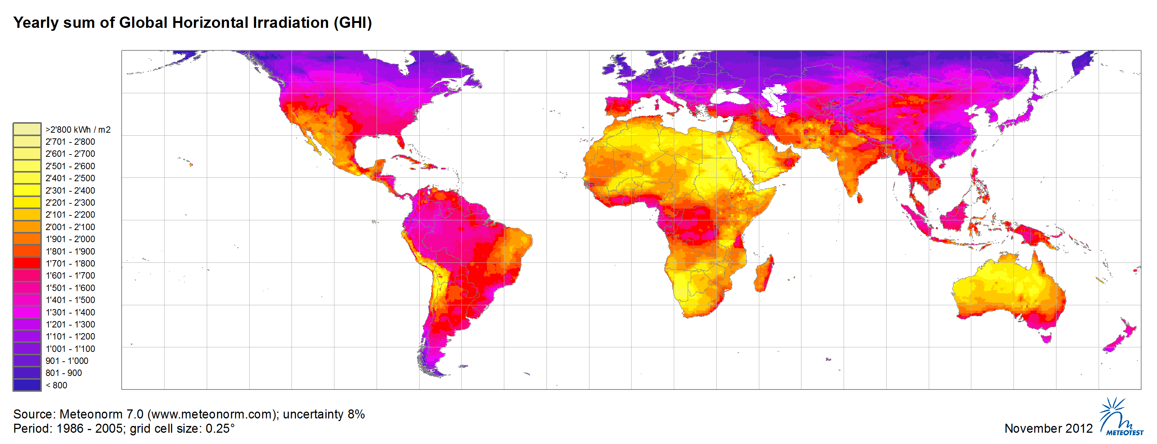
Grow in wide range of light

Slide 20
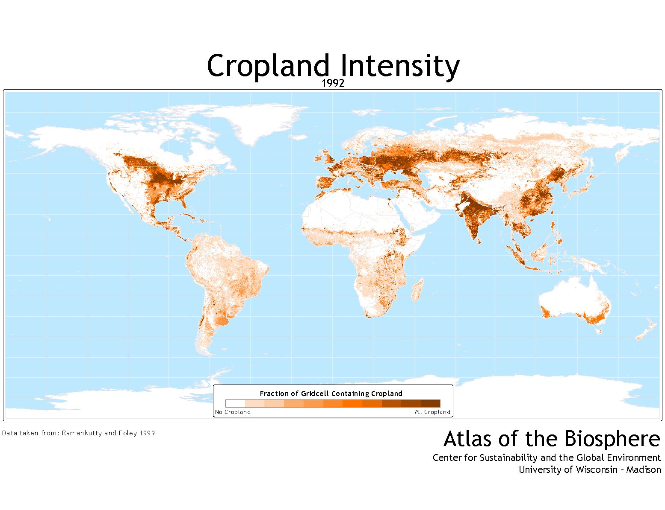
Land not suitable for traditional land plant cultivation could be used for algal cultivation

Slide 21
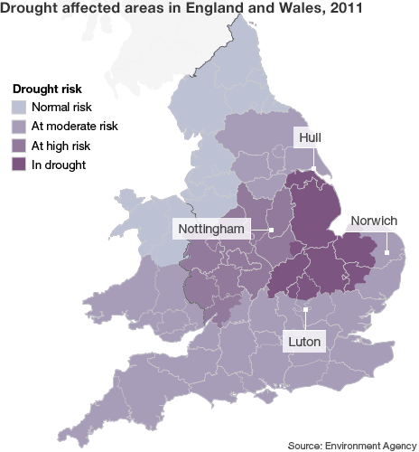
Can growth in salt, brackish or waste water
Low levels of water are causing considerable problems for farmers, with crop yields being hit
BBC 10 June 2011
http://www.bbc.co.uk/news/uk-13722013

Slide 22
Microalgae grow in Salt water
Microalgae grow in both salt and fresh water
The culture of Salt water algae means
No competition for limited fresh water
Use of lower grade land
Use of marsh estuary areas (close to salt water)

Slide 23
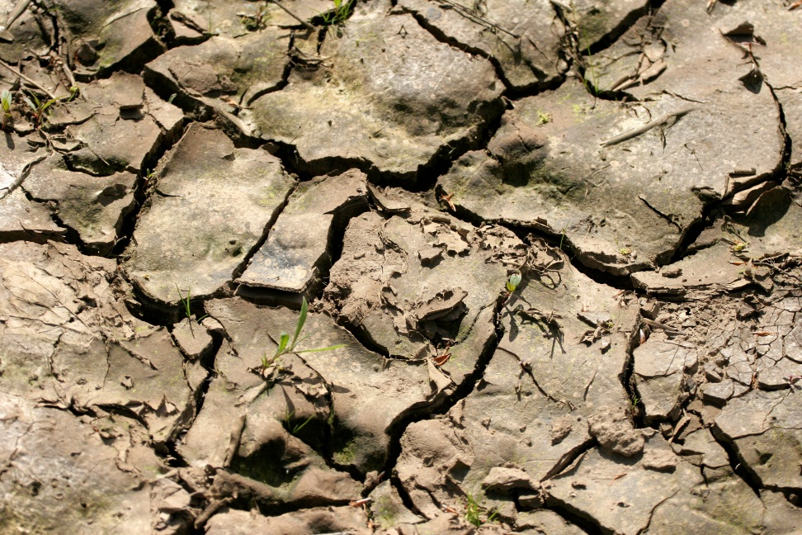
Large amounts of water are needed for microalgae biomass production
Open systems Evaporative water loss
NREL study 5.7 to 6.2 mm d⁻¹
Closed systems Water for cooling
Evaporation from open raceways growing microalgae can be the equivalent to 400 Kg of water for each kilogram of biomass produced

Slide 24
Microalgae “grow” Oil
Many microalgae that live in saline or freshwater environments), produce lipids as the primary storage molecule.
Microalgae have been found to have very high oil contents. In some case above 70%

Slide 25
Examples lipid contents in algal species
Nitzschia palea 80%
Botryococcus braunii 75%
Monallantus salina 72%
Chlorella protothecoides 55%
Scenedesmus dimorphus 40%
Prymnesium parvum 38%
Source University of Cape Town

Slide 26
Algae can be Rich in Poly-unsaturated Fatty Acids
In higher plants, the number of double bonds in fatty acids only rarely exceeds three, but in algae there can be up to six.

Slide 27
Major Fatty Acid Composition of Algae
Species | Major fatty acids (% of total)
 | 14:00 | 16:00 | 16:01 | 16:02 | 16:03 | 18:00 | 18:01 | 18:02 | 18:03 | 18:03 | 18:04 | 20:04 | 20:05 | 22:06
Bacillariophyceae
Thalassiosira pseudonana | 15 | 10 | 29 | 5 | 6 |  |  | 1 |  |  |  | 14 | 15
Chlorophyceae
Parietochloris incisa |  | 10 | 2 | 1 | 1 | 3 | 16 | 17 | 1 | 2 |  | 43 | 1
Dinophyceae
Amphidinium carteri | 2 | 12 | 1 | 2 |  | 2 | 2 | 1 | 3 |  | 19 | 20 |  | 24
Phaeophyceae
Desmarestia acculeata | 4 | 12 | 2 |  |  |  | 7 | 6 | 10 | 2 | 16 | 19 | 19
Dictyopteris membranacea | 6 | 20 | 1 |  |  | 2 | 14 | 14 | 11 | 2 | 11 | 11 | 9
Ectocarpus fasciculatus | 2 | 17 |  |  |  | 1 | 13 | 4 | 15 | 1 | 23 | 11 | 13
Prasinophyceae
Ochromonas danica | 13 | 4 |  |  |  | 3 | 7 | 26 | 12 | 7 | 7 | 8
Rhodophyceae
Gracilaria confervoides | 8 | 18 | 3 |  |  | 1 | 16 | 2 |  | 1 | 1 | 46
Phycodrys sinuosa | 5 | 22 | 5 | 2 | 1 | 3 | 5 | 1 | 1 |  |  | 44 | 2
Porphyridium cruenturn 1380-la |  | 34 | 1 |  |  | 1 | 2 | 12 |  | 1 |  | 40 | 7
BIGOGNO, C., KHOZIN-GOLDBERG, I., BOUSSIBA, S., VONSHAK, A. & COHEN, Z. 2002. Lipid and Fatty Acid Composition of the Green Oleaginous Alga Parietochloris Incisa, the Richest Plant Source of Arachidonic Acid. Phytochemistry, 60,(5), 497-503.

Slide 28
Modern Biotechnology
Although, microalgae have been used for food by humans for thousands of years microalgae culture is one of the modern biotechnologies.
Uni-algal culture was first achieved in 1890 with Chlorella
Modern study of Algal Mass Cultivation is only about 70 years old

Slide 29
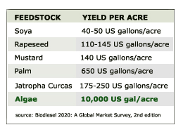
Microalgae can produce many more times the amount of oil per year per unit area of land than oil seed crops.
93 tonnes ha⁻¹ yr⁻¹

Slide 30
But what is the true potential yield?
As early as the 1950s there were complaints of ‘far fetched estimates’ of algal yields and very optimistic estimates of potential algal production have continued to appear. The maximum algal yield for potential sites such as SW USA (annual total solar insolation of 2000 KWh m⁻² year⁻¹) can be simply calculated from the calorific value of the algal based on its composition and the maximum theoretical photosynthetic efficiency. Maximum theoretical algal biomass is of the order of 400 tonnes ha⁻¹ year⁻¹

Slide 31
Maximum Calculated Algal Yields
Algae oil Content | Calorific value | Yield Algae | Yield Algae | Yield Algal Oil
 | kWh kg⁻¹ | Tonnes Ha^{‑1} yr⁻¹ | g m⁻² d⁻¹ | Tonnes Ha^{‑1} yr⁻¹
10% | 5.5 | 401 | 110 | 40
20% | 6.0 | 361 | 99 | 72
30% | 6.7 | 328 | 90 | 99
40% | 7.3 | 301 | 83 | 120
50% | 7.9 | 278 | 76 | 139
60% | 8.5 | 258 | 71 | 155
70% | 9.1 | 241 | 66 | 169
80% | 9.8 | 226 | 62 | 181
90% | 10.4 | 213 | 58 | 192

Slide 32
THEORETICAL MAXIMUM ALGAL OIL PRODUCTION
Kristina M. Weyer, Daniel R. Bush, Al Darzins and Bryan D. Willson http://comste.gov.ph/images/files/TheoreticalMaximum_for%20ALGOIL%206-11-09.pdf
THEORETICAL MAXIMUM ALGAL OIL PRODUCTION
Physical laws dictate the theoretical maximum, it represents a true upper limit to production that cannot be attained regardless of new technology advances.
However, if algal biofuel production systems approach even a fraction of the calculated theoretical maximum, they will be extremely productive compared to current production capability of agriculture-based biofuels.

Slide 33
Realistic Algal Yields
Using a conservative photosynthetic efficiency of only 2.5% (less than a quarter of the theoretical maximum) in the SW USA could yield 25g m⁻² day⁻¹ or 91tons of algae per hectare per year. Seambiotic, in Israel, have recently calculated a similar figure for algae productivity in a similar light level region.

Slide 34
Realistic Algal Yields
NREL Single day productivities reported over the course of one year were as high as 50 grams of algae per square meter per day, and was the long-term target for the program, but consistent long term yield again were probably closer to 25g m ^{–2} day⁻¹ .
Ron Putt at the Department of Chemical Engineering Auburn University has also set growth for microalgae at economically practical rates in the region of 20 g m⁻² day⁻¹.

Slide 35
Realistic Algal Yields
A growth rate of 25g m⁻²day⁻¹ and an oil content of 20 % would produce 91 tonnes of algae per hectare per year and an oil yield of 18.2 tonnes hectare⁻¹ year⁻¹ ,
over 48 times the yield for soy oil.

Slide 36
Algal dry weight yields and photosynthetic efficiencies from published sources.
Reviews
Yield g m⁻² d⁻¹ | Photosynthetic Efficiency % | Suggested Achievable Yield g m⁻² d⁻¹ | Reference
5-21 | 1.2 -3 | 20-28 | (Tamiya, 1957)
15-25 | 0.25 | 30 | (Goldman, 1979a)
3-8 |  |  | (Reijnders, 2009)
 |  | 20 | (Brune et al., 2009)
10-40 |  |  | (Singh and Olsen, 2011)
Published Experimental Data
Yield g m⁻² d⁻¹ | Photosynthetic Efficiency % | Suggested Achievable Yield g m⁻² d⁻¹ | Reference
25 -29 |  |  | (Johnson et al., 1988)
16 | 1.1 – 3.15 | 20 | (Weissman et al., 1989)
15 |  |  | (Laws and Berning, 1991)
16-35 |  |  | (Moheimani and Borowitzka, 2006)
 | 2.3 |  | (Bosma et al., 2007)
 | 2.8 |  | (Strik et al., 2008)

Slide 37
Microalgae capture Carbon Dioxide CO₂
Microalgae like plants use the sun’s energy in photosynthesis to convert CO₂ and water into sugars and other organic compounds.
Photosynthesis in microalgae is generally more efficient because of the simple cellular structure
Microalgae are more tolerant of high CO₂ concentrations
Microalgae cells grow in aqueous suspension and therefore have more efficient access to water, CO₂, and other nutrients

Slide 38
Photosynthesis can be simplified into two reactants (carbon dioxide and water) and two products glucose and oxygen), represented by the chemical equation:
6CO₂ + 6H₂O = C₆H₁₂O₆ + 6O₂
It may be further simplified for the calculation of relative molecular weights
CO2 + H2O ---> [CH2O] + O2
Relative Atomic Weight Relative Molecular Weights
Hydrogen H 1 Carbon Dioxide CO₂ 44 (12 + (16x2))
Carbon C 12 Water H₂O 18 ((1x2) + 16 )
Oxygen O 16 “Formaldehyde” CH₂O 30 (12 + (1x2) + 16)
Oxygen O₂ 32 (2x16)
For every ton of algae produced in it will capture just under one and a half tons of carbon dioxide (44/30)

Slide 39
Algae Can Reduce NOx
SOx and NOx in flue gases were found to have little negative effect on algae NREL, 1998
NOx can provide the Nitrogen Source for the algae NREL, 1998
NOx was reduced by 85% by using algae in a study by MIT
Algae could capture over 60kg of NOx per ton of dry algae produced

Slide 40
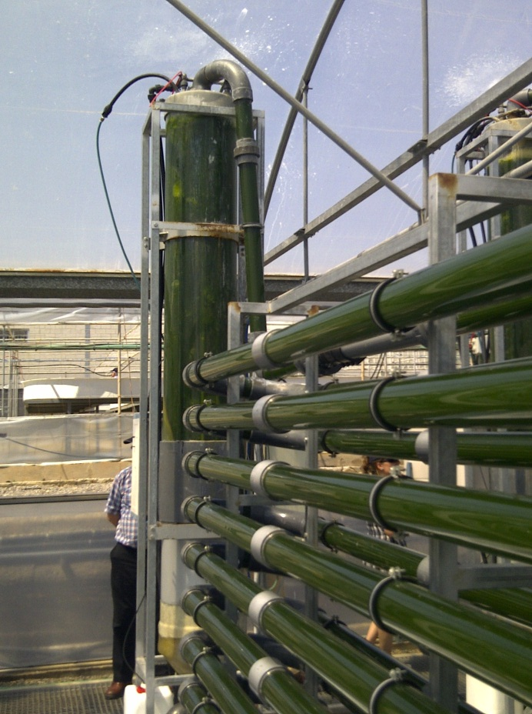
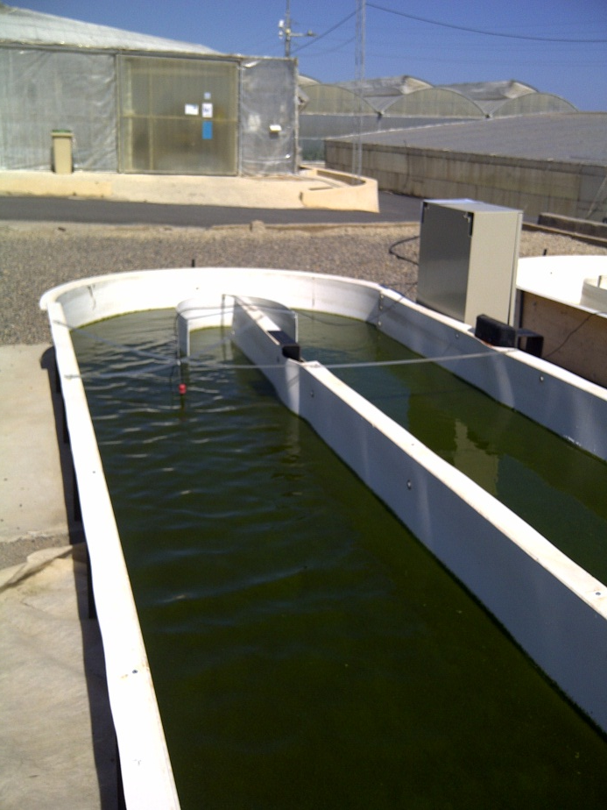
How are microalgae grown?
Closed Systems
Photo-Bioreactors
Open Systems
Race-track ponds

Slide 41
How are microalgae grown?
Closed Systems
Photo-Bioreactors
Open Systems
Race-track ponds
High Capital Cost
Relatively Complex
High degree of Control
Low Risk of Contamination
High Maintenance
Biotechnology
Low Capital Cost
Relatively Simple
Some Environmental Control
Risk of Contamination
Low Maintenance
Farming

Slide 42
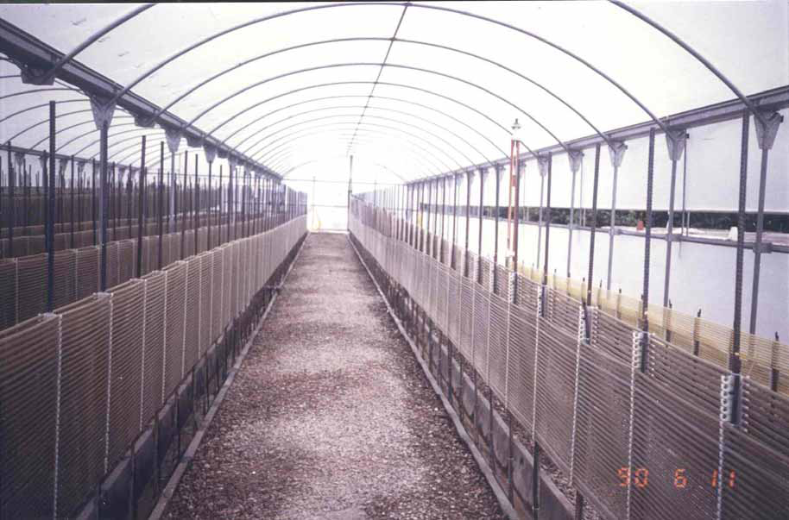
Dunaliella, Murcia, Spain US$ 10 million loss
Ami Ben-Amotz @ NASA November 20, 2008

Slide 43
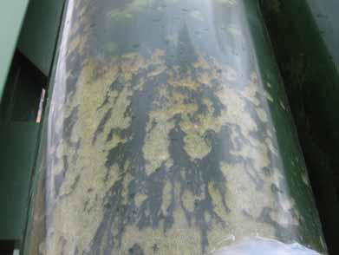
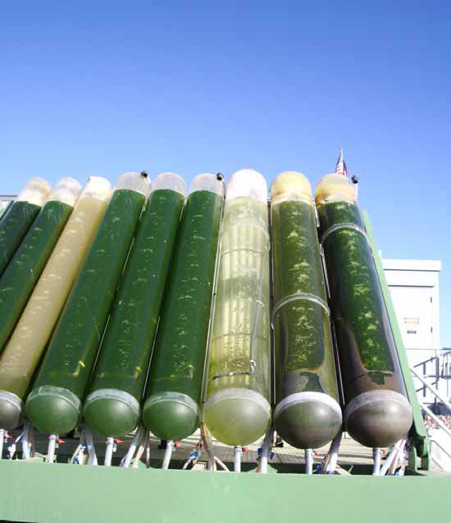
GreenFuel Technologies Co
Arizona, USA
After a few weeks operation - heavy contamination, difficulty to clean
Ami Ben-Amotz @ NASA November 20, 2008

Slide 44
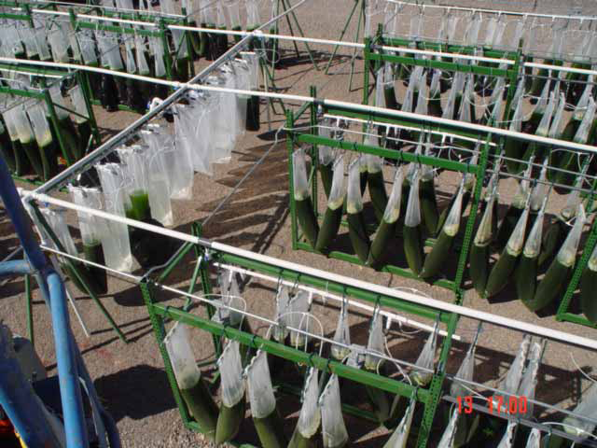
GreenFuel Technologies Co, Arizona, USA
Bags trial, high cost scale up
Ami Ben-Amotz @ NASA November 20, 2008

Slide 45
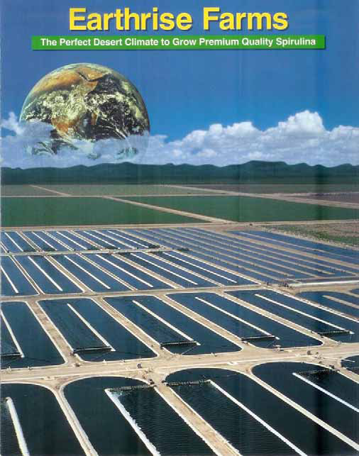
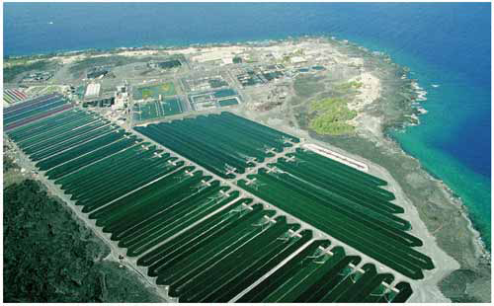
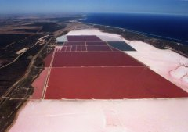
Almost all commercial algae production plants use open ponds
Chlorella, Spirulina and Dunaliella
Cyanotech Hawaii, USA
Cognis, Hutt, Western Australia

Slide 46
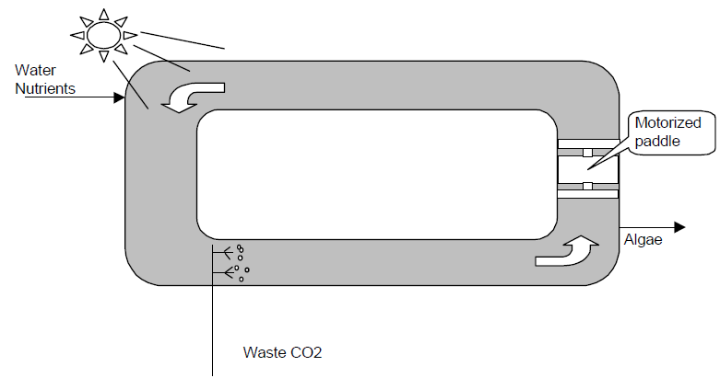
Racetrack Algal Pond
NREL, 1998. A Look Back at the U.S. Department of Energy’s Aquatic Species Program—Biodiesel from Algae. http://www.nrel.gov/docs/legosti/fy98/24190.pdf

Slide 47
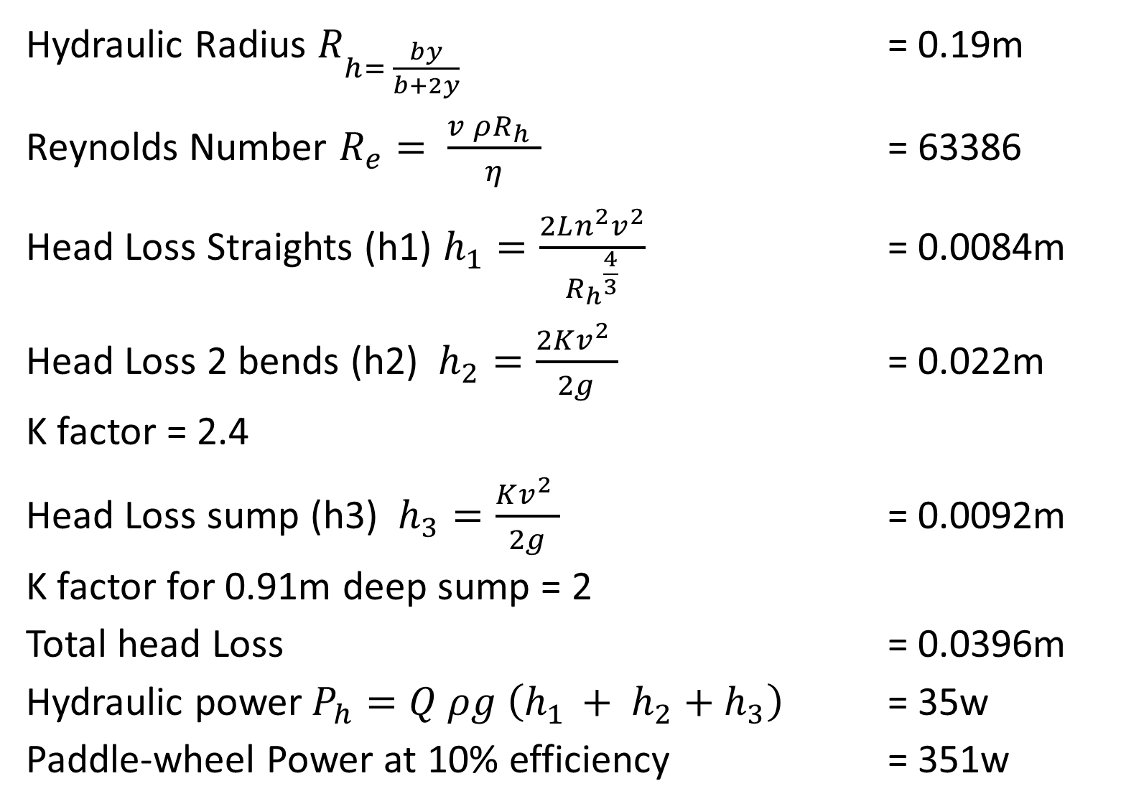
Head losses & Mixing Energy

Slide 48
60% of the total of the energy in the algae could be used in mixing
If algal production is 25g m⁻² d⁻¹ with a calorific value of 4.7Kcal g⁻¹ the paddlewheel will consume 60% of the total of the energy in the algae (area of raceway 103 m², total algal yield 2.58 kg d⁻¹, daily pond algal calorific value 14.1 kWh

Slide 49
Head losses vary with square of mean velocity, but the pumping power varies with the cube of the mean velocity.
The circulation energy in photo-bioreactors has been estimated to be 13 to 28 times that of open raceway ponds and this high operational energy of PBRs may preclude their use for algal fuel production.
STEPHENSON, A. L., KAZAMIA, E., DENNIS, J. S., HOWE, C. J., SCOTT, S. A. & SMITH, A. G. 2010. Life-Cycle Assessment of Potential Algal Biodiesel Production in the United Kingdom: A Comparison of Raceways and Air-Lift Tubular Bioreactors. Energy & Fuels, 24 4062–4077.

Slide 50
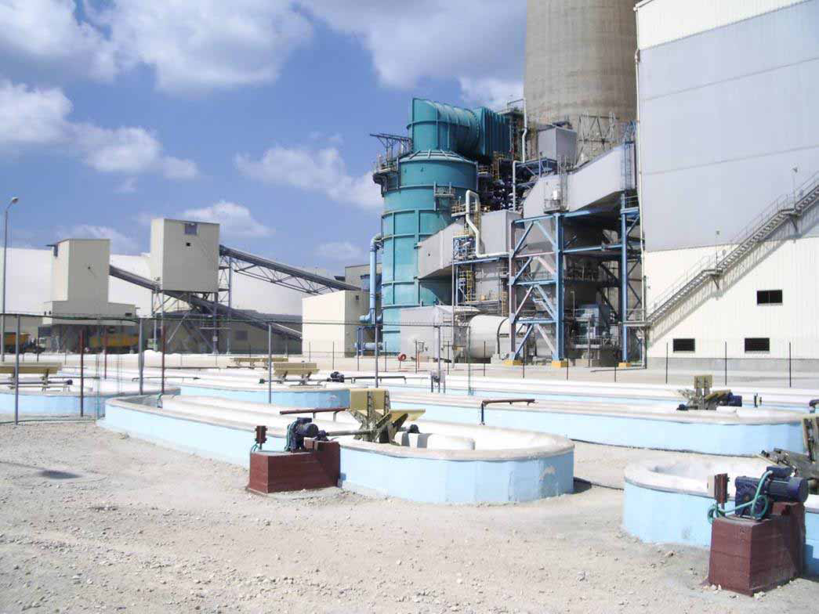

Power Plant Chimney to the Pilot Plant Algae Ponds

Slide 51
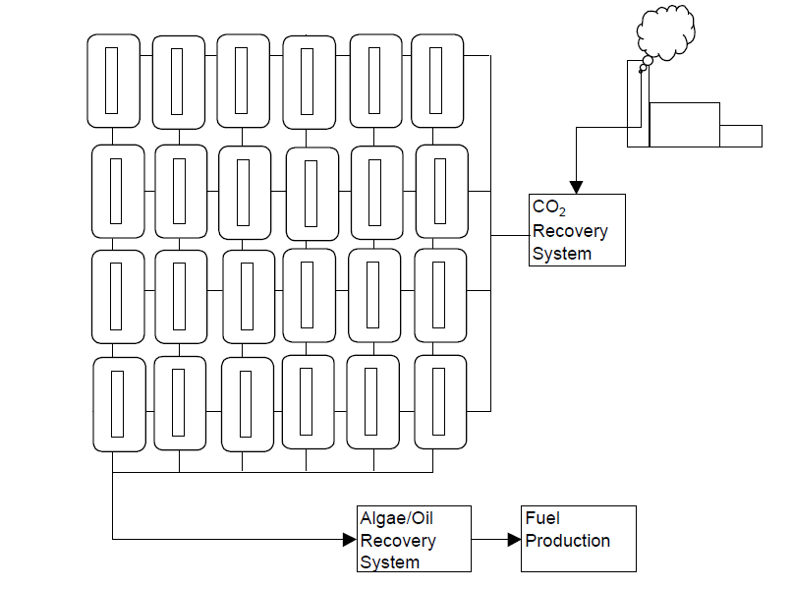
Algae Farm with Power Plant CO2 Capture
NREL, 1998. A Look Back at the U.S. Department of Energy’s Aquatic Species Program—Biodiesel from Algae. http://www.nrel.gov/docs/legosti/fy98/24190.pdf

Slide 52
Required Low Cost Algae Harvesting
“The economy of microalgae production depends on the technology employed for the harvesting and concentrating the algal suspension”
E.W. Becker, Microalgae: Biotechnology & Microbiology 1994

Slide 53

Algal Biofuel Process
Energy Output
O₂
CO₂
Growth
Harvesting
concentration
Energy
Extraction
By-products
Dilute Algae
Conc’ Algae
Water &
Nutrients
Operational Energy Input
Nutrients Recycled

Slide 54
Growth
Open
Closed
Harvesting
Centrifugation
Sedimentation
Energy
Anaerobic Digestion
Trans-esterification
Flocculation
Flotation
Filtration
Other
Direct Combustion
Fermentation
Pyrolysis & Thermal Conversions
Bio-hydrogen
Fuel Cells

Slide 55
The Challenges of Algae Harvesting
Minute Concentration of Algae - around 0.02% dry solids.
Small size – most algae are below 30µm.
Density – Algae are only slight more dense than water.
High Negative Surface Charge – algae remain dispersed in a stable suspension especially during growth phase in optimum conditions and spontaneous flocculation and sedimentation are negligible.

Slide 56
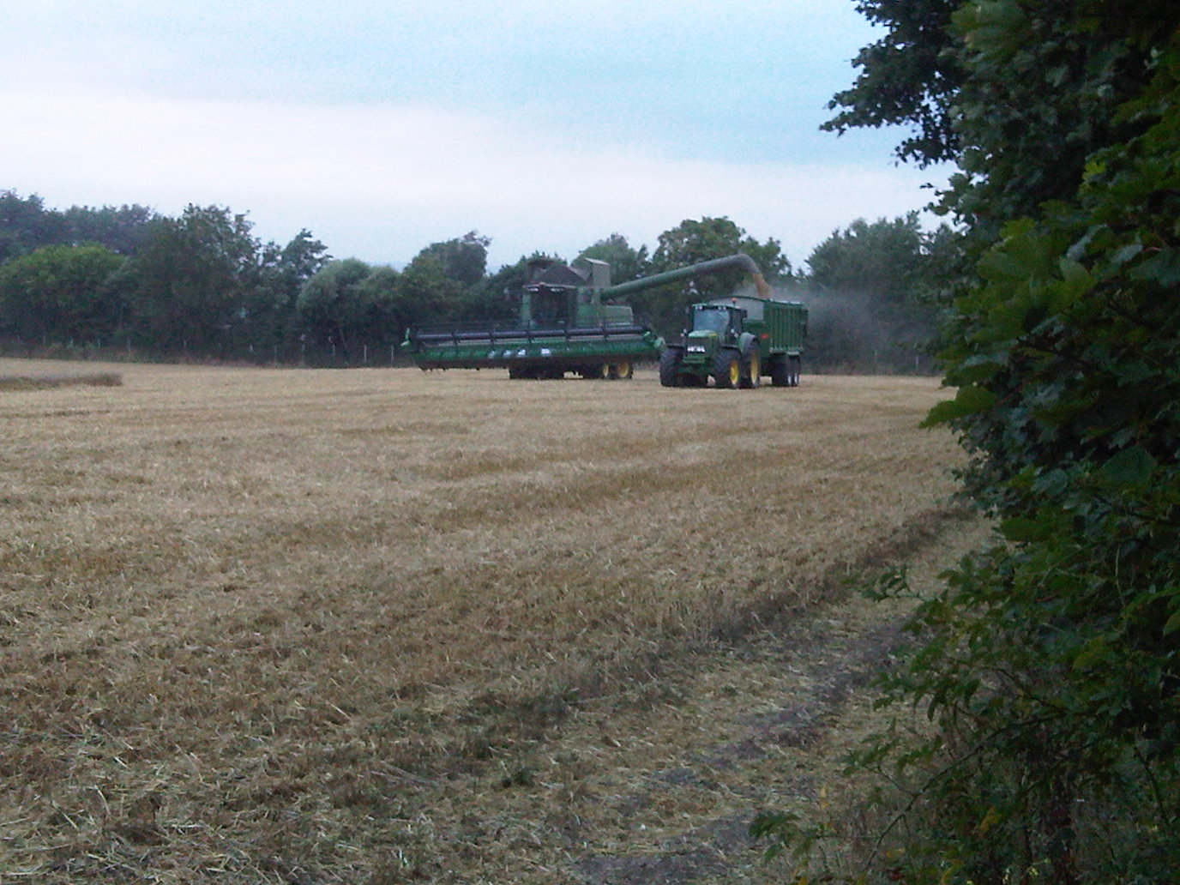
Algae must be Constantly Harvested
Unfortunately algae cannot be left and harvested at the end of a long growing season.
They must be constantly harvested.
Hydraulic retention times 1 to 5 days.

Slide 57
Potential Algal Harvesting Methods
Sedimentation
Flocculation
Floatation
Filtration
Centrifugation
Increasing
Operational
Energy

Slide 58
Comparison of microalgal harvesting methods
(Mohn, 1988, Molina Grima et al., 2003, Shen et al., 2009)
 | Advantages | Disadvantages | Dry solids Output Concentration
Centrifugation | Can handle most algal types with rapid efficient cell harvesting. | High capital and operational costs. | 10-22 %
Filtration | Wide variety of filter and membrane types available. | Highly dependent on algal species, best suited to large algal cells. Clogging and fouling an issue. | 2-27 %
Ultrafiltration | Can handle delicate cells. | High capital and operational costs | 1.5-4 %
Sedimentation | Low cost. Potential for use as a first stage to reduce energy input and cost of subsequent stages. | Algal species specific, best suited to dense non-motile cells. Separation can be slow. Low final concentration | 0.5-3 %
Chemical flocculation | Wide range of flocculants available, price varies, although can be low cost. | Removal of flocculants and chemical contamination | 3-8 %
Flotation | Can be more rapid than sedimentation. Possibility to combine with gaseous transfer. | Algal species specific. High capital and operational cost. | >7%

Slide 59
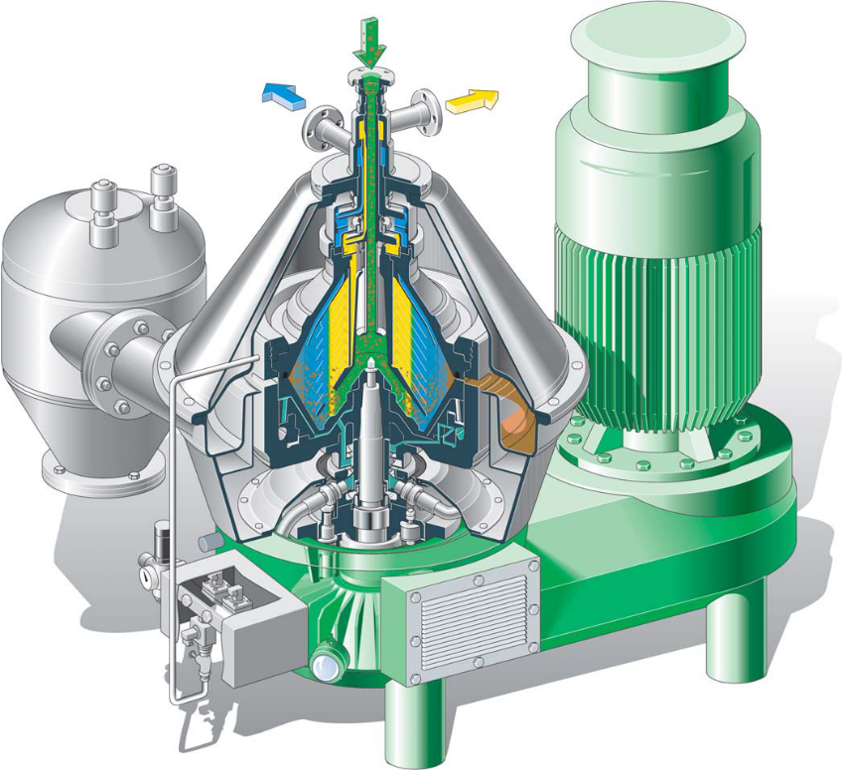
Disc-bowl Centrifuge an Ideal Solution?
A Westphalia HSB400 disc-bowl centrifuge with intermittent self cleaning bowl centrifugal clarifier has a maximum capacity of 95m³ hr⁻¹, but is limited to 35m³ hr⁻¹for algae harvesting. The maximum power of the motor is 75Kw, but is probably normally using around 50kw
Courtesy GEA Westfalia Separator UK Ltd

Slide 60
Elegant Engineering, but at high Energy Cost
0.02% DW algae Feed
0.5% DW algae Feed
0.02% x 35000 = 7kg of dry algal material
20% x 7 =1.4kg of algal oil
90% x 1.4 = 1.26kg biodiesel @ 10.35kwhr ≈ 13kwhrs of fuel calorific value from one hour of centrifugation using 50kwhr
0.5% x 35000 = 175kg of dry algal material
20% x 175 = 35kg of algal oil
90% x 35 = 31.5kg biodiesel @ 10.35kwhr ≈ 326kwhr fuel calorific value, but still an energy input for energy produced of over 15% for the harvesting process.
Could algal suspension be settled in a conical settlement tank, of the type used in the water treatment industry in activated sludge?

Slide 61
Extraction Energy From Algae
Direct Combustion
Oil Extraction Trans-esterification to Biodiesel (FAME)
Anaerobic Digestion
Pyrolysis
Fermentation to Bioethanol
Fuel Cells

Slide 62
Methods of energy extraction from microalgal biomass
 | Utilises entire organic biomass | Requires drying of biomass after harvesting | Primary energy product
Direct Combustion | Yes | Yes | Heat
Pyrolysis | Yes | Yes | Primarily liquid by flash pyrolysis
Gasification | Yes | Yes ^{b} (conventional) | Primarily Gas
Liquefaction | Yes | No | Primarily Liquid
Bio-hydrogen | Yes | No | Gas
Fuel Cells | Yes | No | Electricity
Bioethanol | No ª | No | Liquid
Biodiesel | No | Yes ^{c} | Liquid
Anaerobic digestion | Yes | No | Gas
ª Currently restricted to fermentable sugars as no large-scale commercial production of fuel bioethanol from lignocellulosic materials
^{b} Supercritical water gasification (SCWG) an alternative gasification technology can convert high moisture biomass
^{c} No current commercial process for the wet trans-esterification of wet microalgal biomass

Slide 63
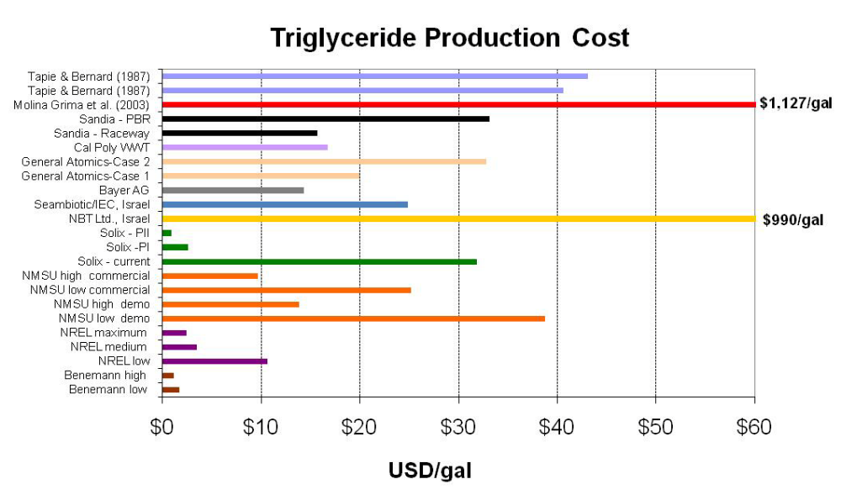
Summary of Algal Lipid Production Cost Estimates
PIENKOS, P. T. 2009. Algal Biofuels: Ponds and Promises. 13th Annual Symposium on Industrial and Fermentation Microbiology. NREL.

Slide 64
Algal Biodiesel is Currently Uneconomic
At present the process of producing fuel from algae would appear to be uneconomic with over 50 algal biofuel companies and none as yet producing commercial-scale quantities at competitive prices. It has been suggested that the cost of production needs to be reduced by up to two orders of magnitude to become economic. Others estimate biodiesel from algae costs at least 10 to 30 times more than making traditional biofuels

Slide 65
~50% of the published LCAs on microalgal biodiesel have a net energy ratio less than 1.
Positive economic/energy studies required
High value co-products
Biogas production by Anaerobic digestion
Use of technology unproven at commercial scale such wet biomass trans-esterification

Slide 66
Anaerobic Digestion of Algae could produce net Energy
 |  | Settlement |  |  |  | Flocculation
 |  | Centrifugation |  |  |  | Centrifugation
Harvesting |  |  |  |  |  | Organic 1 mg l⁻¹ |  |  | Organic 10 mg l⁻¹ |  |  | Alum 120 mg l⁻¹
Algal Harvesting Settlement | % | 60 | 60 | 60 |  | 70 | 90 |  | 70 | 90 |  | 70 | 90
Concentration Factor Settlement |  | 20 | 20 | 20 |  | 30 | 30 |  | 30 | 30 |  | 30 | 30
Algal Harvesting Centrifugation | % | 90 | 90 | 90 |  | 90 | 90 |  | 90 | 90 |  | 90 | 90
Concentration Factor Centrifugation |  | 30 | 30 | 30 |  | 20 | 20 |  | 20 | 20 |  | 20 | 20
Harvesting Equipment Settlement | kWh d⁻¹ | 0.005 | 0.005 | 0.005 |  | 0.005 | 0.005 |  | 0.005 | 0.005 |  | 0.005 | 0.005
Harvesting Equipment Centrifugation | kWh d⁻¹ | 1.4 | 1 | 0.35 |  | 1 | 1 |  | 1 | 1 |  | 1 | 1
Energy Output
Calorific Value of CH4 production | kWh d⁻¹ | 505.20 | 505.20 | 505.20 |  | 589.40 | 757.80 |  | 589.40 | 757.80 |  | 589.40 | 757.80
Energy Input
Mixing | kWh d⁻¹ | 43.67 | 43.67 | 43.67 |  | 43.67 | 43.67 |  | 43.67 | 43.67 |  | 43.67 | 43.67
Total Pumping Energy | kWh d⁻¹ | 29.50 | 29.50 | 29.50 |  | 29.43 | 29.51 |  | 29.43 | 29.51 |  | 29.43 | 29.51
Blower Energy for Pond | kWh d⁻¹ | 28.48 | 28.48 | 28.48 |  | 28.48 | 28.48 |  | 28.48 | 28.48 |  | 28.48 | 28.48
Harvesting Energy | kWh d⁻¹ | 72.22 | 53.78 | 23.82 |  | 52.35 | 62.59 |  | 129.17 | 139.42 |  | 788.70 | 798.95
AD Energy
Heating | kWh d⁻¹ | 20.13 | 20.13 | 20.13 |  | 23.19 | 29.23 |  | 23.19 | 29.23 |  | 23.19 | 29.23
Mixing | kWh d⁻¹ | 4.15 | 4.15 | 4.15 |  | 4.84 | 6.22 |  | 4.84 | 6.22 |  | 4.84 | 6.22
Total AD Input Energy | kWh d⁻¹ | 24.28 | 24.28 | 24.28 |  | 28.03 | 35.45 |  | 28.03 | 35.45 |  | 28.03 | 35.45
Total Operational Energy Input |  | 198.14 | 179.70 | 149.74 |  | 181.95 | 199.70 |  | 258.78 | 276.52 |  | 918.31 | 936.05
Net Energy | kWh d⁻¹ | 307.06 | 325.50 | 355.46 |  | 407.45 | 558.11 |  | 330.63 | 481.28 |  | -328.91 | -178.25
Energy Return on Operational Energy Invested |  | 2.5 | 2.8 | 3.4 |  | 3.2 | 3.8 |  | 2.3 | 2.7 |  | 0.6 | 0.8

Slide 67
Current examples of non-fuel uses of Microalgae
β-carotene produced from Dunaliella
Lina Blue, a blue Phycobiliprotein food colourant, produced from Spirulina
Docosahexaenoic acid (DHA), a polyunsaturated omega-3 fatty acid, produced by heterotrophic culture Crypthecodinium cohnii
Sulphated polysaccharides for cosmetic products from Porphyridium
Food and feed additives for the commercial rearing of many aquatic animals are produced from a variety of microalgal species.

Slide 68
Microalgal Biorefining
Co-production of a spectrum of high value bio-based products (food, feed, nutraceuticals, pharmaceutical and chemicals) and energy (fuels, power, heat) from biomass that could allow the exploitation of the entire microalgal biomass produced.

Slide 69
Biorefineries should be sustainable
The energy inputs required by a biorefinery should be met by bioenergy produced from the refinery.

Slide 70
Good & Bad News
Gene scientist to create algae biofuel with Exxon Mobil
Exxon Mobil expects to spend more than $600 million, which includes $300 million in internal costs and potentially more than $300 million to SGI.
GreenFuel Technologies Closing Down
The Harvard-MIT algae company winds down after spending millions and experiencing delays, technical difficulties

Slide 71
Exxon at Least 25 Years Away From Making Fuel From Algae
“It’s pretty obvious that there’s nothing in the natural world to make the levels (of biofuel) that are needed,”
Craig Venter, the first mapper of the human genome and creator of the first synthetic cell, October 2011
“Creating motor fuels from algae may not succeed for at least another 25 years because of technical hurdles”
Exxon Mobil Corp Chairman and Chief Executive Officer, Rex Tillerson, March 2013

Slide 72
Adelaide scientists on the cusp of a biofuel breakthrough on algal biofuel project in Whyalla
Muradel chief technology officer Associate Professor David Lewis believes its revolutionary process will produce hundreds of millions of dollars worth of oil a year in South Australia within 20 years.
ADELAIDENOW 8th April, 2013

Slide 73
In a survey of more than 380 algae industry contacts showed;
65 % of algae producers said they planned to expand capacity in 2012.
Respondents were optimistic that algae biofuels will be commercially available and competitive with fossil fuels by 2020.
90 % believing that it is at least somewhat likely, and nearly 70 % believing it is moderately to extremely likely
AlgaeIndustryMagazine.com (2012)
http://www.algaeindustrymagazine.com/abo-survey-shows-increased-production-price-competitiveness/?utm_source=feedburner&utm_medium=email&utm_campaign=Feed%3A+AlgaeIndustryMagazine+%28Algae+Industry+Magazine%29

Slide 74


The Debate Continues
“We’re making new investments in the development of gasoline and diesel and jet fuel that’s actually made from a plant-like substance – algae”
“Algae fuel is not likely to be competitive with other forms of fuel anytime in the foreseeable future. It is definitely not a solution to Americans’ urgent energy crisis”
President Barack Obama at the University of Miami Field House in Coral Gables, Fla., Thursday, Feb. 23, 2012
Newton Leroy "Newt" Gingrich 2012 Republican Party presidential nomination. March 2012

