Slide 1
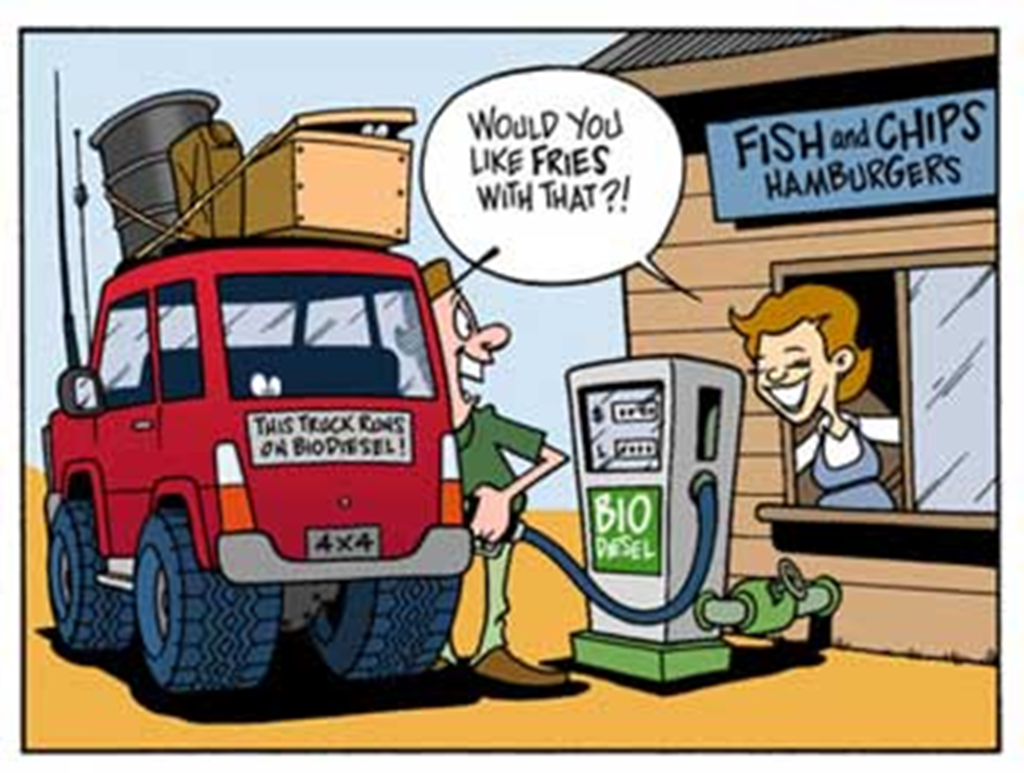
Biodiesel
John J Milledge
Picture from the Joint Services P2 Sustainability Library

Slide 2
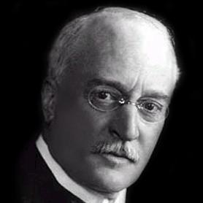
Diesel Engine
Rudolf Diesel patented the diesel (compression ignition) engine in the 1890s
Rudolf Diesel originally demonstrated his diesel engine running on groundnut or peanut oil.

Slide 3
In 1912 Diesel stated: “The diesel engine can be fed with vegetable oils and would help considerably in the development of agriculture of the countries which use it” and that “The use of vegetable oils for engine fuels may seem insignificant today. But such oils may become in course of time as important as petroleum and the coal tar products of the present time.”
Diesel News Australia (2008) http://dieselnews.wordpress.com/2008/05/15/an-amazingly-timely-quote-by-rudolph-diesel-the-inventor-of-the-diesel-engine/

Slide 4
Diesel also said.
“The automobile engine will come, and then I will consider my life's work complete.”
Diesel died in suspicious circumstances in 1913 on a ferry trip to England

Slide 5
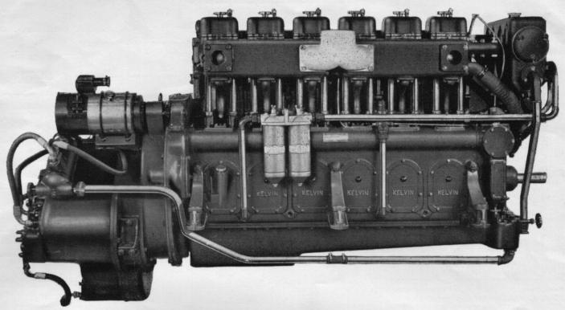
In Diesel engines fuel ignites spontaneously due to the high compress ratio
Kelvin T Marine Diesel Engine Compression Ratio 14:1
The high compression ratio necessitated heavier engines
First uses of Diesel engines was where the extra weight made little or no difference and was offset by the greater efficiency of diesel.
Diesel engines rapidly adopted for marine propulsion
Light weight advanced diesel engines has resulted in an increase in the number of diesel powered cars.

Slide 6
Advantages & Disadvantages of Diesel Engines
Fuel consumption
Safety – lower flash point of diesel
Torque – lower torque peak and flatter torque curve
Reliability & Maintenance – absence of electrical ignition
Longevity – build – lower rpm – fuel lubricity
Engine Weight – due to higher compression ratio
Cost – mainly due to increased weight & strength
Noise

Slide 7
Typical Engine Data Early 1990s
 | Diesel Engine | Petrol Engine
Compression Ratio | 14:1 to 24:1 | 7:1 to 10:1
Thermal Efficiency | 35% to 43% | 25% to 30%
RPM | 2500 to 5000 | 4000 to 6000
The more the fuel air mixture is compressed the greater the amount of power generated. In petrol engines the compression ratio is limited to prevent premature explosive ignition
Wellington, A. & Ashus, A. (1995) Diesel Engines & Fuel Systems 4th Edition

Slide 8
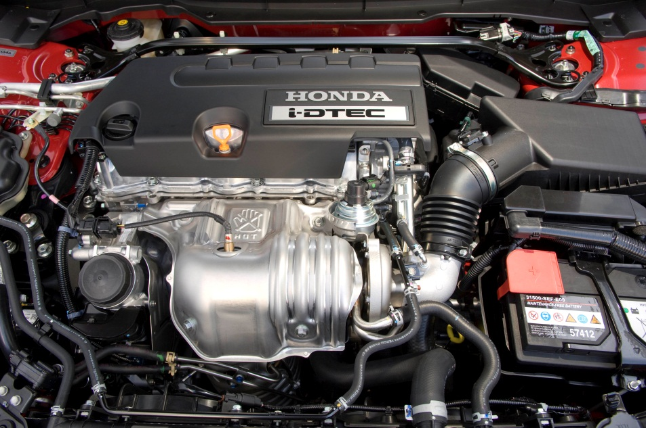
Diesel Car Usage is Increasing in the UK
SMMT
UK New Car Registration Figures
Modern Car Diesel Engine
Year-to-date | Total | Diesel
2011 | 1,822,065 | 920,983
2010 | 1,907,029 | 873,899
% change | -4.50% | 5.40%
Mkt share ’11 |  | 50.50%
Mkt share ’10 |  | 45.80%
Picture courtesy of Honda UK

Slide 9
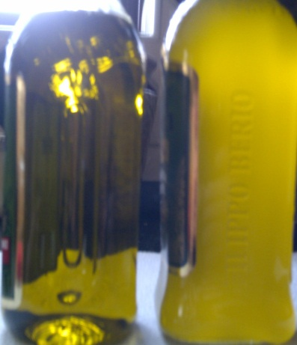
Terminology Diesel & Biodiesel
Flash point – temperature at which petroleum products ignite momentarily, but do not burn continuously
Cloud point – The temperature below which the waxy substances dissolved in an oil begin to precipitate giving the oil a cloudy appearance
Cold filter plug point – the temperature below which the waxy crystal begin to plug a filter of specified dimensions
Leecraft J. (1983) Dictionary of Petroleum Terms 3rd Edition

Slide 10
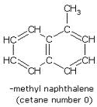

Terminology Diesel & Biodiesel
Cetane Number
A measure of ignition quality of fossil fuel. The higher the Cetane number the more easily the fuel is ignited. Diesel engines normally operate with a Cetane Numbers between 45 to 55.
Based on two reference fuels n-Hexadecane (Cetane) with a high ignition quality and alpha methyl-naphthalene with a low ignition quality. The Cetane number of a fuel is equivalent to % volume of Cetane in the blend of the two reference fuels with the same ignition qualities.
The ASTM D 613 Standard Test Method of Diesel Fuel Oil defining the Cetane number scale was first published in 1941, and has changed little since, with the exception of substituting heptamethylnonane, with an assigned cetane number of 15, for α-methylnaphthalene at the lower end of the scale.
NREL (2004)Compendium of Experimental Cetane Number Data http://www.nrel.gov/vehiclesandfuels/pdfs/sr368051.pdf

Slide 11
CAUTION
Watch the units
Litre, Gallon. US Gallon, Barrel, m³, pounds, kilo, ton, metric ton, short ton, calorie, BTU, joule, kilowatt hour, acre, hectare, foot, yard, metre

Slide 12
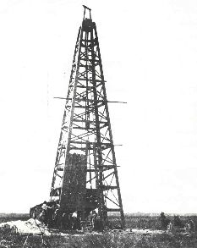
What Happened to Peanut Power ?
Cheap & Readily Available Mineral Diesel
1901 First oil well in Louisiana
Courtesy Louisiana Department of Natural Resources

Slide 13

Straight Vegetable Oil (SVO) as a Diesel Fuel?
“Published engineering literature strongly indicates that the use of Straight Vegetable Oil will lead to reduced engine life. This reduced engine life is caused by the build up of carbon deposits inside the engine, as well as its negative impacts on engine lubricants”
US Dept. Energy (2010) http://www.afdc.energy.gov/afdc/pdfs/47414.pdf

Slide 14
“Straight vegetable oils posed operational and durability problems when subjected to long-term usage in CI (Diesel) engine. These problems are attributed to high viscosity, low volatility and polyunsaturated character of vegetable oils.”
AGARWAL, D., KUMAR, L. & AGARWAL, A. K. 2008. Performance Evaluation of a Vegetable Oil Fuelled Compression Ignition Engine. Renewable Energy, 33,(6), 1147-1156.

Slide 15
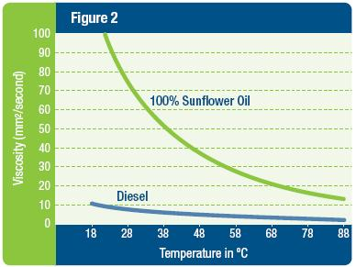
Straight Vegetable Oil has a Higher viscosity and ‘cloud point’
Courtesy US Dept. Energy
US Dept. Energy (2010) http://www.afdc.energy.gov/afdc/pdfs/47414.pdf

Slide 16





The demand for increasing engine performance and reduced emissions from diesel engines has resulted in a new generations of enhanced diesel fuel injection equipment with increased injection pressures and multiple injections.
Higher operating temperatures, pressures and reduced clearances in the injection system result it increased sensitivity to changes in the physical properties of the fuel.
The viscosity of pure Straight Vegetable Oil is much higher than that of diesel fuel .This can cause premature wear of fuel pumps and injectors and can also dramatically alter the structure of the fuel spray coming out of the injectors.

Slide 17
Straight Vegetable Oil - Incomplete Combustion & Deterioration during Storage
Incomplete combustion of vegetable oil can cause long term serious engine problems
  Over time coking of the injectors leads to incomplete atomisation which contributes to its poor combustion
  Carbon deposits can cause piston ring sticking, and subject the engine to massively increased wear
Straight Vegetable Oil can deterioration during storage
  Oxidation results in ‘gum’ production. Gum combusts poorly leading to carbon build up in the engine.
  Gum can transfer into the lubrication oil leading to an increase in its viscosity resulting engine wear

Slide 18
Catalytic Converters and Diesel Particulate Filters
Were not originally designed with Straight Vegetable Oil in mind and can be seriously damaged or poisoned by out-of-spec or contaminated fuel.

Slide 19
What is Biodiesel?
FAME ?

Slide 20
Chemically it is the alkyl esters of fatty acids which are produced by trans-esterification of triglycerides of fatty acids using an alcohol normally methanol or ethanol.
FAME is the fatty acid methanol acid – biodiesel produced using methanol as the alcohol in the trans-esterification

Slide 21

British Definitions

Slide 22
Biodiesel is a fuel that is obtained from a manufacturing process that converts plant oils or animal fats together with alcohol into a fuel that can be used in an internal combustion engine
OFGEM - Office of Gas and Electricity Markets

Slide 23
A diesel quality liquid fuel derived from biomass or waste cooking oils or rendered animal fat, the ester content of which is not less than 96.5% by weight; and the
sulphur content of which does not exceed 0.0001% (1mg/kg) or is nil.
HMRC – HM Revenue & Customs

Slide 24

American Definitions

Slide 25
Biodiesel is a liquid fuel made up of fatty acid alkyl esters, fatty acid methyl esters (FAME), or long-chain mono alkyl esters. It is produced from renewable sources such as new and used vegetable oils and animal fats and is a cleaner-burning replacement for petroleum-based diesel fuel. It is nontoxic? and biodegradable. Biodiesel has physical properties similar to those of petroleum diesel.
US Dept. Energy (2010) http://www.afdc.energy.gov/afdc/fuels/biodiesel_what_is.html

Slide 26
Note: for the rest of the lecture
Diesel = petrochemical diesel i.e. diesel fuel derived from crude oil
Biodiesel = alkyl esters of fatty acids derived from a vegetable or animal source

Slide 27
Biodiesel Acronyms & Abbreviations
FAME Fatty acid methyl ester
SVO Straight Vegetable oil
TAG Triacylglyceride main constituents of vegetable oil
FAAE Fatty acid alkyl ester
RME Rapeseed oil methyl ester
LOME Linseed oil methyl ester
FFA Free fatty acids
MIU Moisture, impurities and unsaponifiable
RBD Refined, bleached and deodorised
CPO Crude palm oil
CRO Crude rapeseed oil etc.
LCA Life Cycle Assessment

Slide 28

Standards and Regulations
“The nicest thing about standards is that there are so many of them to choose from.”
Andrew Stuart "Andy" Tanenbaum; Professor of Computer Science at the Vrije University.

Slide 29

European Specifications

Slide 30
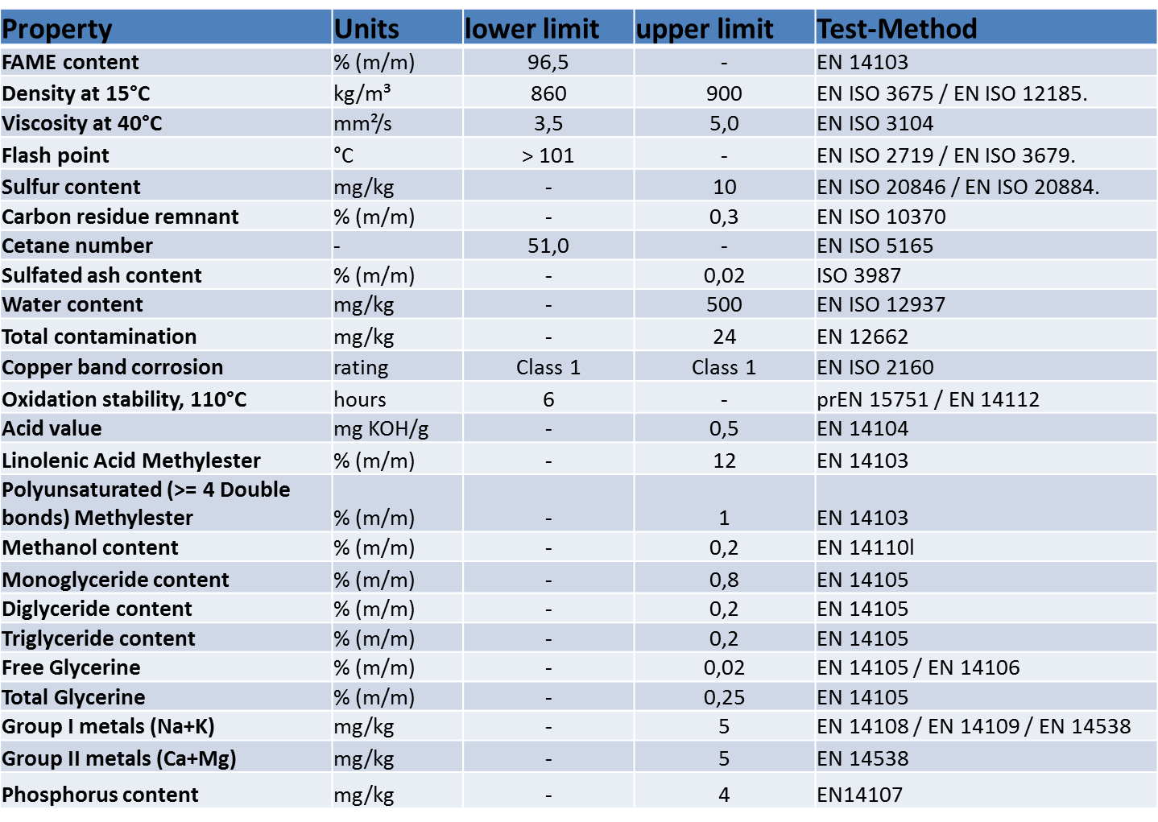
EN14214 (2009) Automotive fuels - Fatty acid methyl ester (FAME) for diesel engines

Slide 31
EN 590 (2010) Automotive fuels. Diesel. Requirements and test methods
Property | Unit | lower limit | upper limit | Test-Method
Cetane index |  | 46,0 | - | EN 4264
Cetane number |  | 51,0 | - | EN 5165 - EN 15195
Density at 15°C | kg/m³ | 820 | 845 | EN 3675, EN 12185
Polycyclic aromatic hydrocarbons | %(m/m) | - | 8 | EN 12916
Sulphur content | mg/kg | - | 10,0 | EN 20846, EN 20884
Flash point | °C | Above 55 | - | EN 2719
Carbon residue (on 10% distillation residue) | %m/m | - | 0,30 | EN 10370
Ash content | % (m/m) | - | 0,01 | EN 6245
Water content | mg/kg | - | 200 | EN 12937
Total contamination | mg/kg | - | 24 | EN 12662
Copper strip corrosion (3 hours at 50 °C) | rating | Class 1 | Class 1 | EN 2160
Oxidation Stability | g/m3 | - | 25 | EN 12205
Lubricity, corrected wear scar diameter (wsd 1,4) at 60 °C | μm | - | 460 | EN 12156-1
Viscosity at 40 °C | mm2/s | 2,00 | 4,50 | EN 3104
Distillation recovered at 250 °C, 350 °C | %V/V | 85 | <65 | EN 3405
Fatty acid methyl ester content | % (V/V) | - | 7 | EN 14078

Slide 32
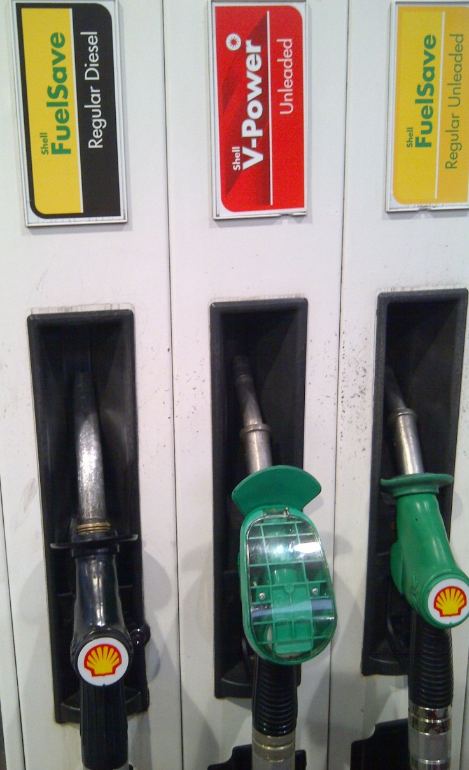
Diesel may contain up to 7% (V/V) of biodiesel (FAME)
Automotive fuels. Diesel. Requirements and test methods BS EN 590:2009+A1:2010

Slide 33

ASTM International
“ASTM International, formerly known as the American Society for Testing and Materials (ASTM), is a globally recognized leader in the development and delivery of international voluntary consensus standards”
“Government regulators often give voluntary standards the force of law by citing them in laws, regulations, and codes. In the United States, the relationship between private-sector standards developers and the public sector has been strengthened with the 1995 passage of the National Technology Transfer and Advancement Act (Public Law 104-113). The Law requires government agencies to use privately developed standards whenever it is at all possible, saving taxpayers millions of dollars in formerly duplicative standards development efforts. There are numerous uses of ASTM standards in the USA include fuel and biodiesel standards.
ASTM (2012) http://www.astm.org/ABOUT/overview.html

Slide 34
US Standards
Biodiesel (B100) should meet specification D6751, a quality standard set by ASTM International.
Blends containing 6% (B6)to 20% (B20) biodiesel must meet the requirements of ASTM D7467.
Biodiesel blends containing 5% or less biodiesel are required to meet the same fuel-quality specifications as conventional diesel fuel, according to ASTM D975.
Requirements for Biodiesel (B100) Blend Stock ASTM D6751
Property | Test Method | Limits | Units
Flash point | D93 | 93.0 min | °C
Kinematic viscosity, 40°C | D445 | 1.9-6.0 | mm2/s
Cetane number | D613 | 47 min

Slide 35
Typical Characteristics of Biodiesel & Diesel
Characteristic | Biodiesel | Diesel
HHV (MJ kg-1) | 41.04 | 45.55
LHV (MJ kg-1) | 37.2 | 41.04
Boiling point (°C) | 315-350 | 180-340
Flash point (°C) | 100-170 | 60-80
Density (kg m-3) | 890 | 835
Cetane number | 51-65 | 51-55
Kinematic viscosity (40°C) (mm2s-1) Centi Stokes | 4.0-6.0 | 1.3- 4.1
NREL (2009) http://www.nrel.gov/vehiclesandfuels/pdfs/43672.pdf
DEFRA (2010) http://archive.defra.gov.uk/environment/business/reporting/pdf/101006-guidelines-ghg-conversion-factors.pdf

Slide 36
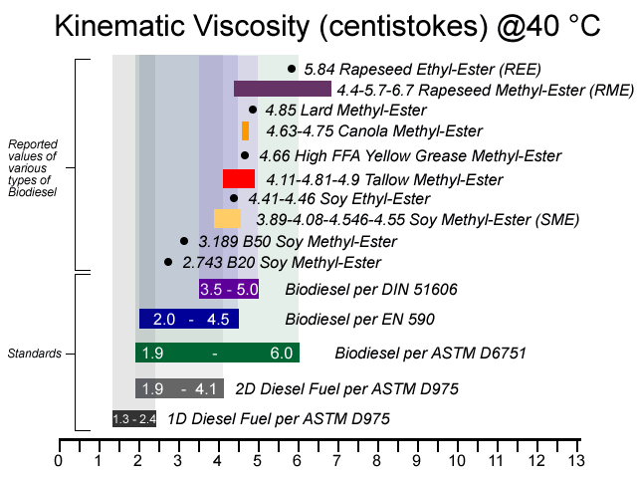
Biodiesel Kinematic Viscosity
Courtesy Brevard Biodiesel
Brevard Biodiesel (2012) http://www.brevardbiodiesel.org/viscosity.html

Slide 37
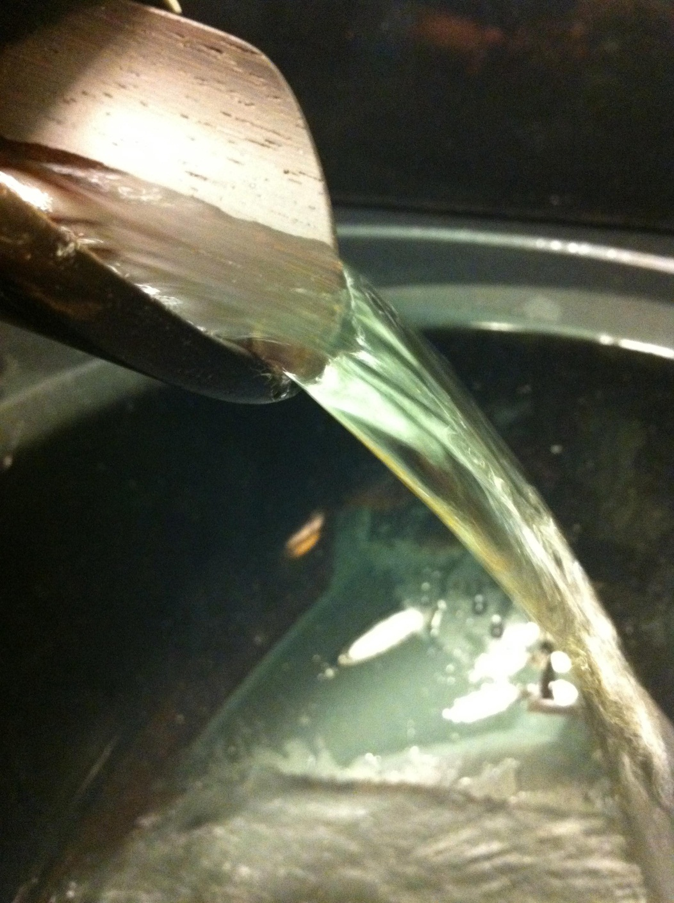
Viscosity
Biodiesel is more viscous than diesel, but less viscous than straight vegetable oil

Slide 38
Kinematic Viscosity (40°C; mm2/s) of saturated and unsaturated fatty compounds
 | Fatty Acid Structure
 | Saturated Fats |  |  |  |  | Unsaturated Fats
 | C10:0 | C12:0 | C14:0 | C16:0 | C18:0 | C18:1 | C18:2 | C18:3
 | Caprylic | Lauric | Mysristic | Palmitic | Stearic | Oleic | Linoleic | Linolenic
TAG | nd | nd | nd | nd | nd | 32.94 | 24.91 | 17.29
Fatty Acid | 5.63 | nd | nd | nd | nd | 19.91 | 13.46 | nd
Methyl Ester | 1.72 | 2.43 | 3.3 | 4.38 | 5.85 | 4.51 | 3.65 | 3.14
Ethyl Ester | 1.87 | 2.63 | 3.52 | 4.57 | 5.92 | 4.78 | 4.25 | 3.42
KNOTHE, G. & STEIDLEY, K. R. 2005. Kinematic Viscosity of Biodiesel Fuel Components and Related Compounds. Influence of Compound Structure and Comparison to Petrodiesel Fuel Components. Fuel, 84,(9), 1059-1065.

Slide 39
Unlike Bioethanol , Biodiesel does not have a consistent chemistry
The properties of Biodiesel are influenced by materials that it is made from:- oils and alcohols
Viscosity increases with Fatty Acid Chain length
Viscosity decreases with increasing degree of unsaturation
Viscosity greater for trans isomers than cis isomers (common natural form)
Viscosity is greater for ethyl ester (ethanol rather than methanol)

Slide 40
Properties Biodiesel from Various Vegetable Oils
Methyl Esters of Vegetable oil | Kinematics viscosity (mm²/s) 40°C | Cetane Num’ | Cloud point (°C) | Flash point (°C) | Density (kg/l) | Lower heating value (MJ/kg)
Peanut | 4.9 | 54 | 5 | 176 | 0.883 | 33.6
Soya bean | 4.5 | 45 | 1 | 178 | 0.885 | 33.5
Palm | 5.7 | 62 | 13 | 164 | 0.88 | 33.5
Sunflower | 4.6 | 49 | 1 | 183 | 0.86 | 33.5
Diesel | 3.06 | 50 | — | 76 | 0.855 | 43.8
FUKUDA, H., KONDO, A. & NODA, H. 2001. Biodiesel Fuel Production by Trans-esterification of Oils. Journal of Bioscience and Bioengineering, 92,(5), 405-416.

Slide 41

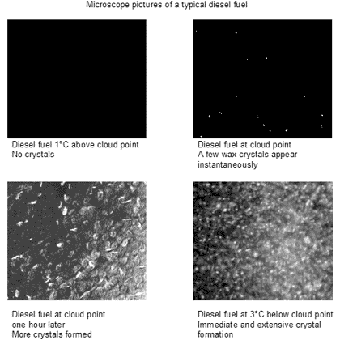
Biodiesel has a lower Calorific Value than diesel
Biodiesel has a higher Cloud Point Temperature.
Picture courtesy Phase Technology

Slide 42




Not All Vehicle Manufactures Approve B100 Biodiesel Use

Slide 43

Bio Fuels use with Mercedes-Benz Vehicles.
For Passenger Cars
Mercedes-Benz cannot give general approval for the unrestricted use of biodiesel in passenger car diesel engines because various components in the engines and fuel systems are incompatible with the fuel, and could suffer serious damage if pure biodiesel is used. Blends of up to 7% biodiesel with 93% mineral oil diesel may be treated as "normal" diesel fuel for use in all our current engine range provided that the mineral diesel meets EN590 standard, and the biodiesel part of the mixture meets EN 14214.
Vito & Sprinter statement:
Higher concentrations of biodiesel may NOT be used on this series of engines.
Concentrations of biodiesel greater than 7% may well cause the following effects in the CDI fuel system:
1. Swelling / deterioration of rubber seals and hoses.
2. Damage to high-precision metal components such as the high pressure fuel pump
Emailed Statement February 2012

Slide 44

VW Biodiesel statement
3rd March 2010
Volkswagen Group does approve the use of diesel fuel containing up to 7% Biodiesel in all of their diesel vehicles. Important: BS EN 590 is approved for vehicles fitted with a Diesel Particulate Filter (DPF).
B30 Biodiesel
Volkswagen Group does not approve the use of B30 Biodiesel in any of its vehicles.. The use of this fuel in Volkswagen Group vehicles may invalidate the engine and exhaust system warranty.
100% Biodiesel
Certain Volkswagen Group vehicle models are approved to run on 100% Rapeseed Methyl Ester (RME) Biodiesel. 100% RME Biodiesel compatible parts fitted during manufacture of the vehicle
Volkswagen Group has only approved the use of Rapeseed Methyl Ester (RME) to standard DIN EN 14214. No other Biodiesel can be used.
• Vehicles that do not have the factory preparation for Biodiesel cannot use 100% Biodiesel.
• Vehicles fitted with a Common Rail fuel injection system cannot use 100% Biodiesel.
• Vehicles fitted with Pumpe-Duse injectors cannot use 100% Biodiesel.
• Vehicles fitted with a Diesel Particulate Filter (DPF) cannot use 100% Biodiesel, however EN590 containing up to 7% Biodiesel is approved for use with DPF.
• 100% Biodiesel vehicles cannot be used in temperatures below -10°C.
• The use of 100% Biodiesel may slightly reduce the driving performance of the vehicle and slightly increase the fuel consumption.
• The use of 100% Biodiesel may increase the frequency of the maintenance schedule on the vehicle

Slide 45

Volvo trucks trail Bio-DME (Di-Methyl-Ether)
Volvo Truck Corporation does not accept more than 7% biodiesel in diesel since nitric oxide emissions increase drastically and the injection system can be damaged.
If the customer wishes to use B30, they recommend that the oil changing intervals be halved in order to eliminate the risk of dilution of the engine oil. Biodiesel can have washing like characteristics which causes faster clogging of the fuel filters
The cold properties for biodiesel are not particularly good. Pure Biodiesel can produce deposits already at -10°C.
Energy efficiency well-to-wheel is low, it also produces more NOx emissions with the present vehicle fleet and there is a limited potential for production of large quantities
Based on telephone discussion with Volvo UK and Volvo Official Websites 2012

Slide 46



Scania and DAF 100% bio-diesel conforming to the EN14214 standard may be used in new engines that have more tolerant components
Renault Trucks are more cautious and only allow 30% blend (B30)
A more stringent maintenance programme must also be followed which includes halving intervals between oil and filter changes and inspection of seals on a regular basis
Lemon, D. (2008) Biofuels: The Motor Industry Perspective. SCI London

Slide 47


New Holland supports the use of biodiesel
Nearly all New Holland diesel engines come with the flexibility to run on blend from full diesel to 100% biodiesel (B100).
Picture courtesy New Holland
New Holland recently manufactured diesel engines will run on B100, including electronic injection engines with common rail technology

Slide 48
Biodiesel has a solvent effect.
It can clean vehicle’s fuel system and release deposits accumulated from previous diesel fuel use. The release of deposits may initially clog filters. This issue is less common with lower-level blend of biodiesel.
Many vehicle manufacturers suggest a more frequent service interval with biodiesel especially when first changing from diesel to biodiesel.

Slide 49
Higher-level blends of biodiesel above B20 can impact on fuel hoses and fuel pump seals that contain elastomer compounds incompatible with biodiesel
US Dept. Energy (2011) http://www.afdc.energy.gov/afdc/pdfs/47504.pdf

Slide 50

Natural or nitrile rubber compounds, polypropylene, polyvinyl, and Tygon materials are particularly vulnerable to degradation with prolonged exposure by B100. Many elastomers used after 1993 may compatible with B100 (Viton/Teflon)
http://www.biodiesel.org/pdf_files/fuelfactsheets/Materials_Compatibility.pdf

Slide 51
Compatibility of Elastomers in Palm Biodiesel
1.Mass and volume for both nitrile rubber and polycholoprene are increased with increasing the concentration of biodiesel while for fluro-viton, these remain almost constant for all fuels.
2.After immersion into biodiesel, tensile strength, elongation and hardness were significantly reduced for both nitrile rubber and polychloroprene while very negligible changes were found for fluoro-viton.
3.Due to exposure into biodiesel, more pits and cracks were formed on the surface of nitrile rubber and polychloroprene as compared to those on fluoro-viton.
HASEEB, A. S. M. A., MASJUKI, H. H., SIANG, C. T. & FAZAL, M. A. 2010. Compatibility of Elastomers in Palm Biodiesel. Renewable Energy, 35,(10), 2356-2361.

Slide 52
Materials to Avoid with Biodiesel
Polycholoroprene
Nitrile, Hydrogenated HNBR
Butadiene BR
Hypalon CSM (chlorosulfonated polyethylene)
Natural Rubber NR (Isoprene)
Neoprene
Polystyrene
Styrene-Butadiene SBR
Polyethylene
Polysulfide
Ethylene Propylene EPDM
Nitrile NBR
Hodam, R (2008) Biodiesel:Compatibility and Regulation. National tanks Conference , Atlanta. http://biodiesel.ucsd.edu/forum/getattachment.php?id=27

Slide 53
Biodiesel is less stable than Diesel in Storage
The highly oxidised biodiesel and biodiesel blends have significantly different physical and chemical characteristics to non-oxidised biodiesel and biodiesel blends
Fuel filter blocking and fuel separation was observed during testing of the highly oxidised biodiesel, but phase separation and filter blockage did not occur during testing of B5 and B20 blends prepared from biodiesel which had been less extensively oxidised and which contained lower water and sediment contents.
NREL (2005) Impact of Biodiesel on Fuel System Component Durability
http://www.nrel.gov/vehiclesandfuels/npbf/pdfs/39130.pdf

Slide 54
Viscosity & Insoluble Matter Increase in Biodiesel with Storage
The total insoluble content and viscosity of biodiesel samples increased with increasing storage time.
Insoluble products can block fuel filters or fuelling systems.
Deterioration was greater in daylight rather dark conditions.
Oils with high concentration of unsaturated fatty acid linoleic and linolenic acid (characterized by two and three unsaturated bonds) deteriorated faster.
BOUAID, A., MARTINEZ, M. & ARACIL, J. 2007. Long Storage Stability of Biodiesel from Vegetable and Used Frying Oils. Fuel, 86,(16), 2596-2602.

Slide 55
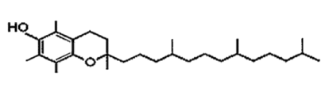
Biodiesel Stability from Used Vegetable Oil
The degree of unsaturation in vegetable makes them susceptible to thermal and/or oxidative polymerization, which may lead to the formation of insoluble products Naturally occurring antioxidants like tocopherols prevent the oxidation of vegetable oils, but amount of natural antioxidants in biodiesel is quite variable. During the use of vegetable oils in frying most of the antioxidants are consumed, so one could have assume poor oxidative stability of biodiesel made from used frying oil, but no significant differences were found between biodiesel made from fresh rapeseed oil and used frying oil.
α-tocopherol (Vitamin E)
MITTELBACH, M. & GANGL, S. 2001. Long Storage Stability of Biodiesel Made from Rapeseed and Used Frying Oil. Journal of the American Oil Chemists Society, 78,(6), 573-577.

Slide 56
Stability of the Biodiesel Blend Depends on Stability of Biodiesel
Stability of the Biodiesel is the main factor that affects the stability of B5 and B20 blends, independent of diesel fuel aromatic content, sulphur level, or stability.
Fatty acid chains contain primarily 16 or 18 carbon atoms and from 0 to 3 double bonds. When multiple double bonds are present, they are often separated by a single methylene carbon. The relative oxidation rates for these C18 esters are C18:3 > C18:2 C18:1(3) because the di- and tri- unsaturated fatty acids contain the most reactive sites for initiating the auto-oxidation chain reaction sequence. The oxidation rate correlates with the total number of methylene sites, not with the total number of double bonds.
MCCORMICK, R. L. & WESTBROOK, S. R. 2009. Storage Stability of Biodiesel and Biodiesel Blends. Energy & Fuels, 24,(1), 690-698.
NOTE. In higher plants, the number of double bonds in fatty acids only rarely exceeds three, but in algae there can be up to six.
BIGOGNO, C., KHOZIN-GOLDBERG, I., BOUSSIBA, S., VONSHAK, A. & COHEN, Z. 2002. Lipid and Fatty Acid Composition of the Green Oleaginous Alga Parietochloris Incisa, the Richest Plant Source of Arachidonic Acid. Phytochemistry, 60,(5), 497-503.

Slide 57
A Review of Biodiesel as Vehicular fuel
Biodiesel blends of the oil above 20% (B20) generally caused maintenance problems and in some cases engine damage although some studies found studies no long-term adverse effects
There was a slight decrease in power and a slight increase in fuel consumption.
The lubricant properties of the biodiesel were better than diesel, which could help increase engine life.
Biodiesel produced much less NOx ?and HC and virtually no SOx and lower increases in CO2 at global level.
HAHID, E. M. & JAMAL, Y. 2008. A Review of Biodiesel as Vehicular Fuel. Renewable and Sustainable Energy Reviews, 12,(9), 2484-2494.

Slide 58
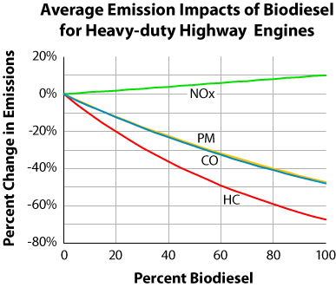
Courtesy US EPA
US EPA (2002) A Comprehensive Analysis of Biodiesel Impacts on Exhaust Emissions. Draft Technical Report

Slide 59
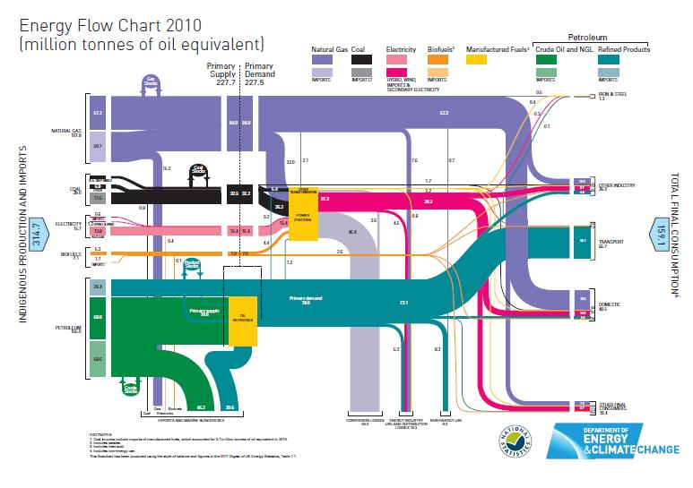
Biofuels are a Small but growing sector in the UK Energy Usage
Courtesy Department of Energy & Climate Change
https://www.gov.uk/government/uploads/system/uploads/attachment_data/file/65897/5939-energy-flow-chart-2011.pdf

Slide 60

In 2009, biofuels made up 2.9% of total petrol and diesel sales in the UK, with the majority of this being accounted for by biodiesel:
Biodiesel for use in diesel vehicles accounted for 77% of total biofuels
(~1 billion litres, ~4% of diesel sales).
Around 9% of biodiesel in the UK market are produced using domestic feed-stocks.
Climate Change Committee (2011) The Renewable Energy Review
http://hmccc.s3.amazonaws.com/Renewables%20Review/The%20renewable%20energy%20review_Printout.pdf

Slide 61
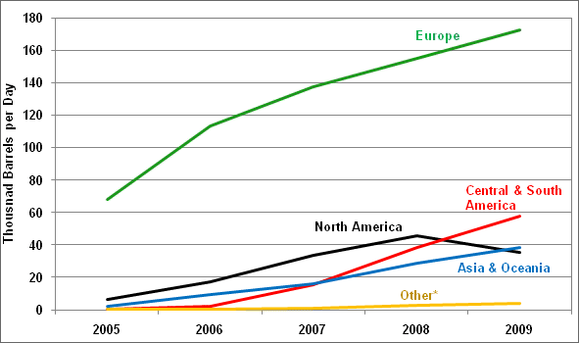
World Biodiesel Production Increasing
Courtesy US Department of Energy
“Europe has been the dominant region for biodiesel production with increased production each year since 2005. The declining biodiesel production in the United States beginning in 2008 is likely due to changes in Federal subsidies for biodiesel as well as changes in foreign trade policy and the downturn of the economy”. US Dept. Energy (2011)
http://www1.eere.energy.gov/vehiclesandfuels/facts/2011_fotw662.html

Slide 62
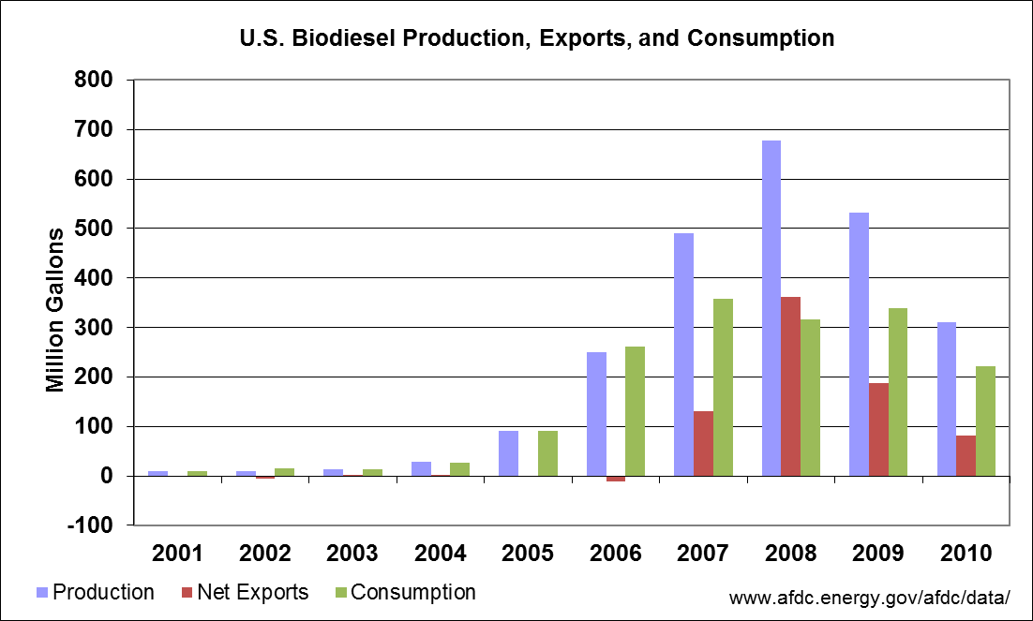
Courtesy US Department of Energy

Slide 63
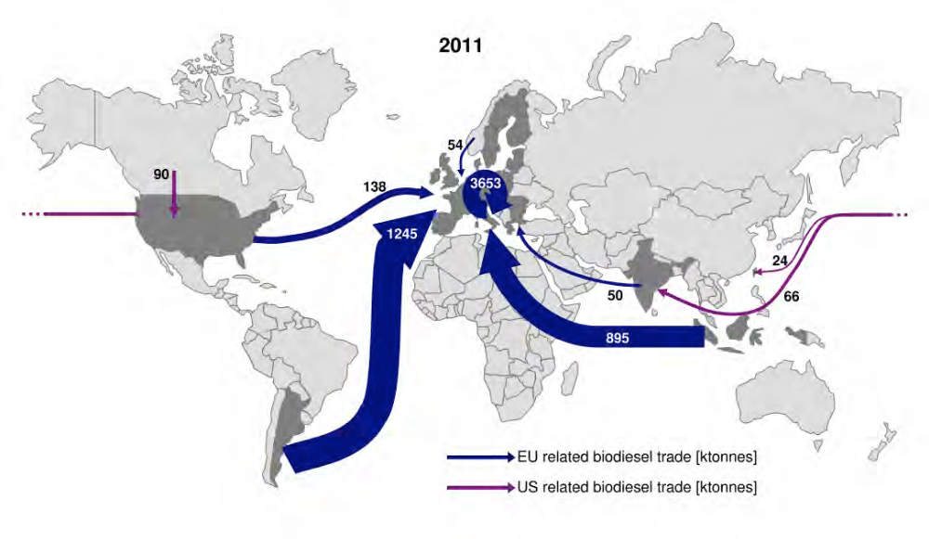
Global biodiesel trade streams in 2010 [ktonnes].
Courtesy German Union for the Promotion of Oils and Protein Plants (UFOP)
Ecofsy (2011)International biodiesel markets: Developments in production and trade
http://www.ufop.de/downloads/Ecofys-UFOP_Marktbericht_Biodiesel_EN_2011.pdf

Slide 64
The EU Renewable Energy Directive (RED)
Set targets for biofuel energy content in transport fuels as follows:
2005 - 2%
2010 - 5.75%
2020 - 10%
Only Sweden and Germany met the 2005 target
The EU Fuel Quality Directive requires a 10 percent reduction in average life-cycle emissions of fuels between 2010 and 2020 – fuels suppliers are responsible for delivering this target
Lemon, D. (2008) Biofuels: The Motor Industry Perspective. SCI London

Slide 65

EU and Member States spent approximately €3.1 billion on biofuel support in 2010.
House of Commons (2011). Standard Note SN/SC/3691 Biofuels

Slide 66

UK has Reduced Biodiesel Support and is Reviewing Growth Targets
Budget 2008 announced that the duty differential for biofuels would end in 2010-11.
Secondary legislation was introduced to maintain the 20 pence per litre duty differential for biodiesel produced only from waste cooking oil for a period of two years
The Coalition Government has concerns about the sustainability of biofuels it does not plan to increase biofuel targets before 2014 and it is reviewing biofuel policy.
Targets are likely to increase from 2014 to 2020 to meet European targets.

Slide 67
How “Green” is Biodiesel?
Gallagher stated that the EU target of 10% of transport fuel used by 2020s is unlikely to be met sustainably and the introduction of biofuels should therefore be slowed while we improve our understanding of indirect land-use change and effective systems are implemented to manage risks.
The Gallagher Review of the indirect effects of biofuels production, Renewable Fuels Agency , 2008 .
http://webarchive.nationalarchives.gov.uk/20110407094507/renewablefuelsagency.gov.uk/reportsandpublications/reviewoftheindirecteffectsofbiofuels
The Gallagher Review was a major study commissioned by the UK Government on the ‘indirect’ or ‘displacement’ impacts of biofuels on carbon emissions from land use change and on food security
The Debate Continues

Slide 68
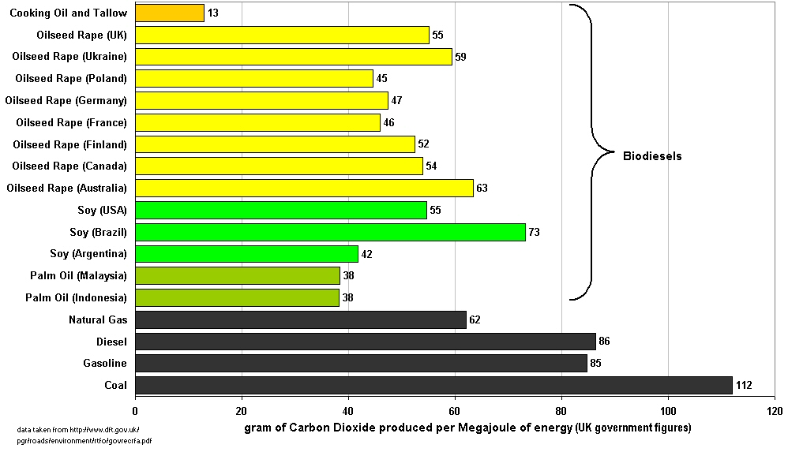
Carbon dioxide Emissions Biodiesel v Fossil Fuels
http://www.dft.gov.uk/pgr/roads/environment/rtfa/govrecrfa.pdf Link no longer active

Slide 69
The Composition of Oil Feed-stock Determines the Physical Properties of the Biodiesel
Reminder

Slide 70
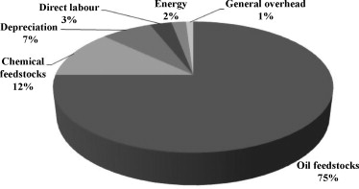
Feed-stocks are the Main Financial Cost in Biodiesel Production
LIM, S. & TEONG, L. K. 2010. Recent Trends, Opportunities and Challenges of Biodiesel in Malaysia: An Overview. Renewable and Sustainable Energy Reviews, 14,(3), 938-954.
The Biodiesel Handbook, Edited by Gerhard Knothe , Jon Van Gerpen , and Jürgen Krahl AOCS Publishing 2005
Similar data has appeared in a number of publications and the originator of this chart is to be confirmed.

Slide 71
Plant Oil Feed-stocks
Soybean
Rapeseed
Palm,
Sunflower,
Cottonseed
Peanut
Jatropha
Coconut
Vegetable oils are more expensive than other feed-stocks for biodiesel production but require the least processing in order to produce the fuel

Slide 72
Fatty Acid Composition of Vegetable oils
Vegetable oil | Fatty acid composition % by weight
 | 16:01 | 18:00 | 20:00 | 22:00 | 24:00 | 18:01 | 22:01 | 18:02 | 18:03
Corn | 11.7 | 1.85 | 0.24 | 0 | 0 | 25.2 | 0 | 60.6 | 0.48
Cottonseed | 28.3 | 0.89 | 0 | 0 | 0 | 13.3 | 0 | 57.5 | 0
Peanut | 11.4 | 2.39 | 1.32 | 2.52 | 1.23 | 48.3 | 0 | 32 | 0.93
Rapeseed | 3.49 | 0.85 | 0 | 0 | 0 | 64.4 | 0 | 22.3 | 8.23
Soybean | 11.8 | 3.15 | 0 | 0 | 0 | 23.3 | 0 | 55.5 | 6.31
Sunflower | 6.08 | 3.26 | 0 | 0 | 0 | 16.9 | 0 | 73.7 | 0
MARCHETTI, J. M., MIGUEL, V. U. & ERRAZU, A. F. 2007. Possible Methods for Biodiesel Production. Renewable & Sustainable Energy Reviews, 11,(6), 1300-1311.

Slide 73
Animal Oil Feed-stocks
Tallow (from beef processing)
Lard (from pork),
Poultry fats,
Fish oils
Due to the saturated fat content in many animal they are often solid at room temperature and may require heating prior to process (increased energy input) and may produce a fuel with poor cold weather properties.
May be a cheaper feedstock than vegetable oils as they can be waste products. Also may need further processing to remove free fatty acids and polar contaminants

Slide 74
Waste Oils & Fats
Food processing waste e.g. frying oils
Grease collected from wastewater
Soap-stock – a by-product of the refining of vegetable oils
Often require pre-processing to remove high concentrations of contaminants;
Trap grease high water content.
Frying oils high Free Fatty Acid (FFA) content
Cheaper feedstock than vegetable oils since they are waste products
Previously had a lower fuel duty in the UK

Slide 75
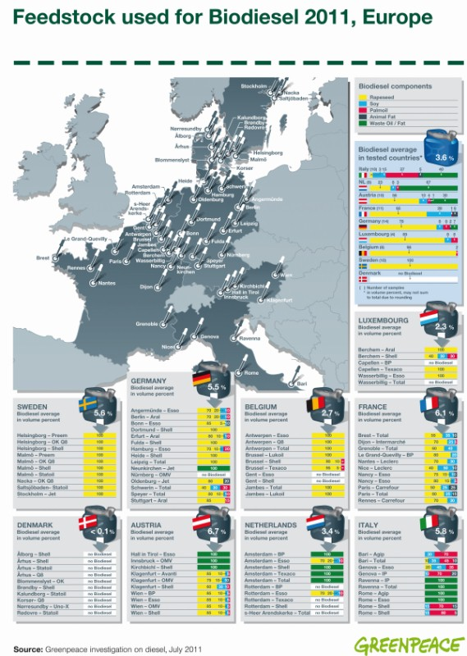
Courtesy Greenpeace

Slide 76
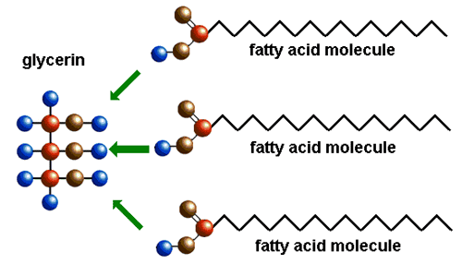
Triglyceride Structure

Slide 77
The Degree of Feedstock Preparation
Depends on the Feedstock
Fully refined oils– Refine, bleached and deodorised (RBD oils )
Crude oils may required refining
Waste oils and fats of animal origin require more pre-treatment
Oil seeds or Whole crop require preparation including oil extraction

Slide 78
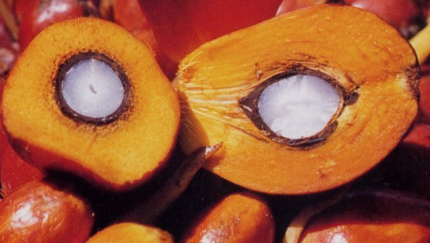
Palm Oil
Oil can be extracted from both the fruit and the seed, crude palm oil (CPO) from the mesocarp and palm-kernel oil from the endosperm which is quite different to palm oil
.
Pericarp
40- 60% Palm Oil%
Kernel
45 -50% Palm Kernel Oil

Slide 79
Simplified Oil Extraction Refining Process
Heat sterilisation to prevent bacterial or enzymatic activity
Sterilisation
Stripping
Mechanical and heat to break cells and release oil
Digestion
Screw Press or solvent extraction
Press
Waste Oil
Separation
FFA neutralised and resulting soaps centrifuged off. FFA < 0.1%
Neutralise
Acidic or enzymatic de-gumming - phosphatides, phospholipids, and lecithins. Degummed oil phosphorus <30 (ppm).
Degum
Bleach
Bleaching by carbon or bleaching earth
De-oderisation
Steam applied at low pressure

Slide 80
Palm Oil Processing Generates Large Volumes of Effluent & Waste
5 to 7.5 tons of water required to process 1 ton of crude Palm Oil
50 % of the water is discharged Palm Oil Mill Effluent (POME)
Rupani, F.P. et al.(2010). Review of Current Palm Oil Mill Effluent (POME) Treatment Methods:
Vermicomposting as a Sustainable Practice
World Applied Sciences Journal 11 (1): 70-81,

Slide 81
Characteristic of Raw POME
Temperature (°C) | 80-90
pH | 4.7
Biochemical Oxygen Demand BOD3; 3days at 30 °C mg/L | 25000
Chemical Oxygen Demand mg/L | 50000
Total Solids (T.S) mg/L | 40500
Total Suspended Solids (T.S.S) mg/L | 18000
Total Volatile Solids (T.V.S ) mg/L | 34000
Oil and Grease (O&G ) mg/L | 4000
Ammonia-Nitrate (NH3-N) mg/L | 35
Total Kjeldahl nitrogen (TKN) mg/L | 750
Rupani, F.P. et al.(2010). Review of Current Palm Oil Mill Effluent (POME) Treatment Methods:
Vermicomposting as a Sustainable Practice
World Applied Sciences Journal 11 (1): 70-81

Slide 82
World Bank Effluent Guideline for Vegetable Oil Processing
pH | 6-9
Biochemical Oxygen Demand BOD mg/L | 50
Chemical Oxygen Demand mg/L | 250
Oil and Grease (O&G ) mg/L | 10
Total Kjeldahl nitrogen (TKN) mg/L | 50
When one or more members of the World Bank Group are involved in a project, these Environmental Guidelines are applied
IFC (2007)
http://www.ifc.org/ifcext/enviro.nsf/AttachmentsByTitle/gui_EHSGuidelines2007_VegetableOilProc/$FILE/Final+-+Vegetable+Oil+Processing.pdf

Slide 83
Trans-esterification
C3H5(OOCR)3 + 3CH3OH → 3RCOOCH3 + C3H5(OH)3
Catalyst
Triglyceride + Methanol → Methyl ester + Glycerine
FAME
Biodiesel

Slide 84
Trans-esterification
Trans-esterification is a reversible reaction where glyceride reacts with an alcohol in the presence of a catalyst, forming a mixture of fatty acids esters and an alcohol .
Using triglycerides results in the production of glycerol.

Slide 85
Esters are named by the alkyl group and the fatty acid from which they are formed
Fatty acid | Methyl Ester
Caprylic acid (C8) | Methyl Caprylate
Capric acid (C10) | Methyl Caprote
Lauric acid (C12) | Methyl Laurate
Myristic acid (C14) | Methyl Myristate
Palmitic acid (C16) | Methyl Palmate
Stearic acid (C18) | Methyl Stearate
Oleic acid (C18:1) | Methyl Oleate
Linoleic acid (C18:2) | Methyl Linoleate
Linolenic acid (C18:3) | Methyl linolenate

Slide 86
Choice of Alcohol
Methanol or Ethanol?
Generally Methanol is used in trans-esterification for biodiesel
The reactions proceed at lower temperatures if methanol rather than ethanol is used.
Generally methanol is cheaper than ethanol.
Regulations - BS EN 14214:2008+A1:2009
Automotive fuels – Fatty acid methyl ester (FAME) for diesel engines

Slide 87
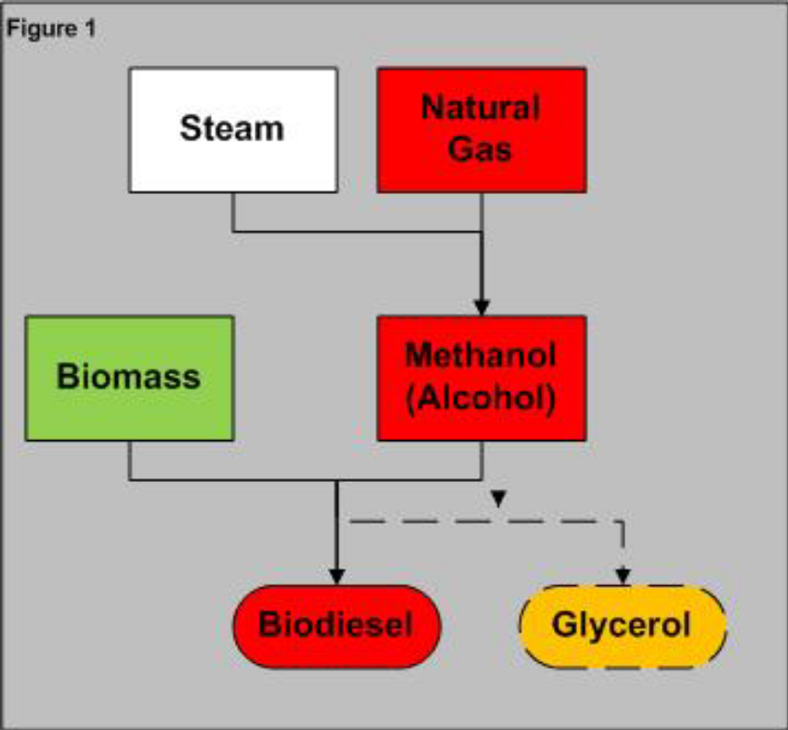
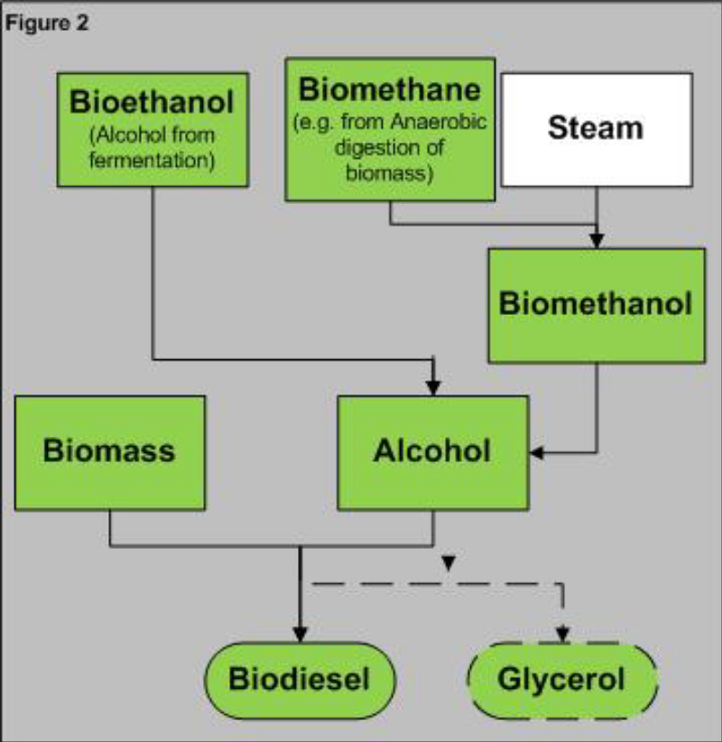
Is the Alcohol from Fossil Fuel?
Most methane is from fossil CH₄
Biogas as the methane source
http://www.ofgem.gov.uk/Sustainability/Environment/RenewablObl/Documents1/Biodiesel%20Decision.pdf

Slide 88
Catalysts
Alkaline (most common on an industrial scale)
Sodium Hydroxide, NaOH (caustic soda)
Potassium hydroxide (KOH) (caustic potash)
Acid
Sulphuric acid,
Hydrochloric acid
Sulphonic acid
Solid (Insoluble in Methanol)
Alkali earth metal oxides
Transition metal oxides
Supercritical Alcohol
Enzymes
LIN, L., ZHOU, C. S., VITTAYAPADUNG, S., SHEN, X. Q. & DONG, M. D. 2011. Opportunities and Challenges for Biodiesel Fuel. Applied Energy, 88,(4), 1020-1031.

Slide 89
Alkaline Catalysts
Advantages
Up to 4000 times faster than acid trans-esterification
Alkalis are less corrosive than acids
High alkyl ester yield (>98%)
Disadvantages
Very sensitive to the presence of water and free fatty acids. The alkali catalyst will react with the free fatty acids to form soaps. Soaps decrease potential product yield and result in the formation of emulsions that cause separation problems
Need to treat the alkaline effluents generated
High water consumption during washing
Glycerol formed is contaminated with alkaline catalyst
Typical conditions
1-2% molar catalyst 1-6 hours 30-65 °C

Slide 90
Acid Catalysts
Less sensitive to FFAs
Slower and necessitate higher reaction temperatures (70-240 ºC) and higher substrate molar ratio (up to 30:1)
Corrosive
Have been largely ignored

Slide 91
Supercritical alcohol
Advantages
FFA are converted into esters
Very rapid rate of reaction < 20 minutes
Simplified purification of product
(only contaminated with acyl receptor e.g. methanol)
Can be combined with alkali catalysed trans-esterification to obtain 90% reaction completion in 1 minute
Disadvantages
Expensive capital investment - pressure vessels
No industrial scale process

Slide 92
Supercritical alcohol trans-esterification reaction conditions
Vegetable oil | Molar ratio | Alcohol | Temperature and pressure | Reaction time | Conversion (%)
Sunflower oil | 40:01:00 | Methanol | 350 °C, 200 bar | 40 min | 96
Rapeseed oil | 42:01:00 | Methanol | 350 °C, 45 MPa | 240 s | 95
Hazelnut kernel oil | 41:01:00 | Methanol | 350 °C, NA | 300 s | 95
Jatropha oil | 40:01:00 | Methanol | 350 °C, 200 bar | 40 min | >90
Soyabean oil | 40:01:00 | Methanol | 310 °C, 35 MPa | 25 min | –
Coconut oil, palm kernel oil | 42:01:00 | Methanol | 350 °C, 19.0 MPa | 400 s | 95–96
VYAS, A. P., VERMA, J. L. & SUBRAHMANYAM, N. 2010. A Review on Fame Production Processes. Fuel, 89,(1), 1-9.

Slide 93
Comparisons between catalytic methanol process and supercritical alcohol method for biodiesel from vegetable oils by trans-esterification
 | Alkali catalysed method | Supercritical alcohol method
Catalyst | Alkali | None
Reaction temperature (K) | 303–338 | 523–573
Reaction time (min) | 60–360 | 7–15
Biodiesel (wt.%) | 96 | 98
Free fatty acids | Saponified products | Esters, water
DEMIRBAS, A. 2007. Recent Developments in Biodiesel Fuels. International Journal of Green Energy, 4,(1), 15-26.

Slide 94
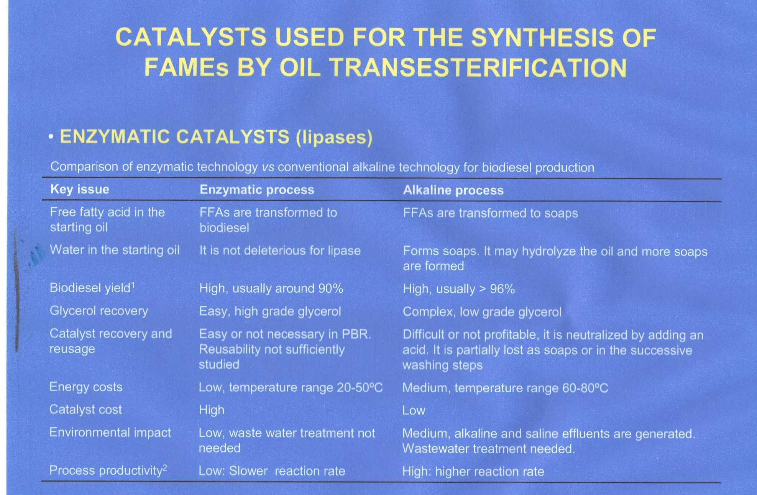
Courtesy of Alfonso Robles Medina, Chemical Engineering Department, Almeria University

Slide 95
In situ trans-esterification
The oil extraction step can be eliminated by performing the reaction directly in the lipids contained in organic matter eliminating lipid extraction and possibly drying.
Currently at Research stage
VELASQUEZ-ORTA, S. B., LEE, J. G. M. & HARVEY, A. 2012. Alkaline in Situ Transesterification of Chlorella Vulgaris. Fuel, 94,(0), 544-550.

Slide 96
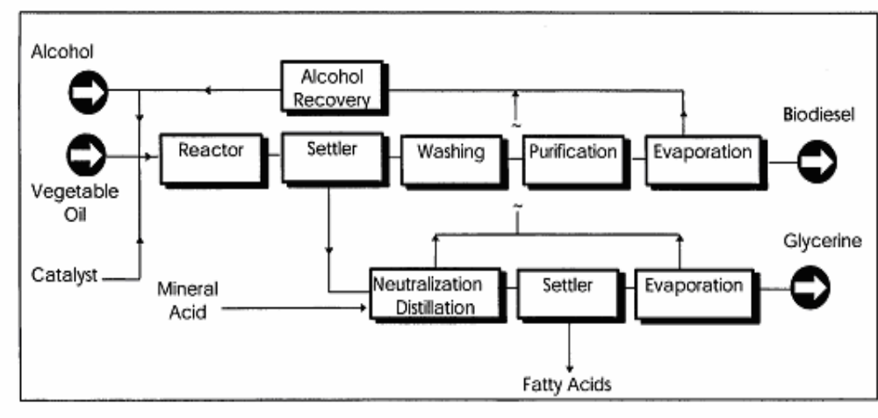
Flowchart of the process of esterification to create biodiesel fuel.
Courtesy National Biodiesel Board

Slide 97
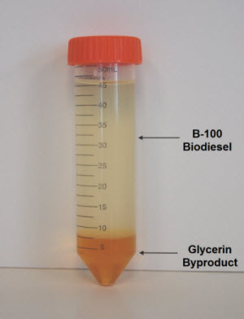
Separation of Glycerol and Raw Biodiesel
Gravimetric separation – settlement (1-8 hours),
Centrifugation (<5 minutes)
Microfiltration
with ceramic membranes
Hydrocyclone (in development)
Separation normally performed at neutral pH (with acid addition) to maximise rate of separation
The density of biodiesel and glycerol are 880 kg m⁻³ and 1050 kg m⁻³ .
Courtesy SRS Engineering Corporation

Slide 98
Negative effects of contaminants on biodiesel and engines
Contaminants | Negative effect
Methanol | Deterioration of natural rubber seals and gaskets, lower flash points (problems in storage, transport, and utilization, etc.), Lower viscosity and density values, Corrosion of pieces of Aluminium (Al) and Zinc (Zn)
Water | Reduces heat of combustion, corrosion of system components (such as fuel tubes and injector pumps) failure of fuel pump, hydrolysis (FFAs formation), formation of ice crystals resulting to gelling of residual fuel, Bacteriological growth causing blockage of filters, and Pitting in the pistons
Catalyst/soap | Damage injectors, pose corrosion problems in engines, plugging of filters and weakening of engines
Free fatty acids (FFAs) | Less oxidation stability, corrosion of vital engine components
Glycerides | Crystallization, turbidity, higher viscosities, and deposits formation at pistons, valves and injection Nozzles
Glycerol | Decantation, storage problem, fuel tank bottom deposits Injector fouling, settling problems, higher aldehydes and acrolein emissions, and severity of engine durability problems
ATADASHI, I. M., AROUA, M. K., AZIZ, A. R. A. & SULAIMAN, N. M. N. 2011. Refining Technologies for the Purification of Crude Biodiesel. Applied Energy, 88,(12), 4239-4251.

Slide 99
Raw Biodiesel Washing
Conventionally wet washing is the most employed technique to remove impurities such as soap, catalyst, glycerol and residual alcohol from biodiesel.
The major disadvantage in the use of water to purify biodiesel is increase in cost and production time.
Separation of biodiesel phase from water phase is difficult and produces large amount of wastewater and requires gentle agitation to prevent emulsification.
Up to 10 L of wastewater is produced per litre of biodiesel.
Refining of crude biodiesel accounts for 60–80% of the total oil refining cost
ATADASHI, I. M., AROUA, M. K., AZIZ, A. R. A. & SULAIMAN, N. M. N. 2011. Refining Technologies for the Purification of Crude Biodiesel. Applied Energy, 88,(12), 4239-4251.

Slide 100
Dry Washing of Raw Biodiesel
Ion exchange resins and magnesium silicate have been used as substitute for water washing to remove biodiesel contaminants.
This technique is employed in commercial plants, but understanding of the chemistry of dry washing is limited.
Dry washing process may not meet EN14214 in terms of methanol required in biodiesel fuel.
.

Slide 101
Biodiesel Drying
Required to remove water and methane.
Usually performed using vacuum driers to lower drying temperature (excessive heating can damage the fuel)
Use of molecular sieves has also been used

Slide 102
Biodiesel is the Main Driver of Glycerol Supply
The glycerine contents of fats and oils range from 9 to over 13% for coconut oil
Approximately 100 kg of Glycerol from 1 ton of oil feedstock
Biodiesel accounted for only 9% of the supply of Glycerol in 1999 but 64% in 2009
Croda Glycerine Market Brief

Slide 103
Glycerol Refining
Important due to its numerous applications in different industrial products such as moisturisers, soaps, cosmetics and medicines,
Unrefined bi-product glycerol is about 50% glycerol in composition containing water, salts, unreacted alcohol, and unused catalyst
The unused alkali catalyst is neutralized with acid and the alcohol in the glycerol phase is removed through a vacuum evaporator. The alcohol vapour is condensed and reused
LEUNG, D. Y. C., WU, X. & LEUNG, M. K. H. 2010. A Review on Biodiesel Production Using Catalysed Transesterification. Applied Energy, 87,(4), 1083-1095.

